Slide 1
Higher
Dimensions Of Space
Part 1 of 2
Larry Smith

Slide 2
My Credentials

Slide 3
Update Notice
This presentation is a slightly updated version of one I gave to the NYPG in September 2013.
  Actually, I just checked, and it looks like I first gave this presentation on May 14, 2010. So this might be the third time I’ve given this talk to the group!
It’s only slightly upgraded because, since 2013, either most of the ideas in string theory haven’t changed much, or advances in string theory have been made either in the depth of the mathematics involved, or in significantly more sophisticated physics, which are difficult to present to a non-specialist audience.
For example, from the Wikipedia article on string theory, “Branes are frequently studied from a purely mathematical point of view, and they are described as objects of certain categories, such as the derived category of coherent sheaves on a complex algebraic variety, or the Fukaya category of a symplectic manifold.”
  “Bojemoi! This I know from nothing!” – Tom Lehrer, Lobachevsky.

Slide 4
Big Presentation No-No
It can be frustrating to be given a presentation in which the presenter (moi) just reads the text on the slide. Which, of course, you could do yourself.
So who needs the presenter?
But you’ll find that I’ll wind up just reading what’s on several (maybe even, many) slides. Especially this one!
  I’ll try to add a few side comments here and there, but no promises.
Why? Because I deliberately design my presentations to be comprehensible without a presenter. This way you can come back to the slides and, if you choose, study them at your own pace.
This also has the additional advantage that when two senses are used (sight/reading and hearing), this information is stored in different parts of the brain, making it easier to understand/recall.
So please excuse the no-no.

Slide 5
Disclaimer
We’re going to be talking about string theory. And that’s all it is at this point, a theory, not a fact.
Still, as we’ll see, we have compelling reasons for believing that it’s something worth investigating.
People were hoping that the Large Hadron Collider (LHC) would detect signs that string theory (or at least its underpinning, supersymmetry – see later) was true. But so far no smoking gun. But there has also been no evidence that disproves string theory.
Do I personally believe in string theory? Well, I don’t have the expertise to be competent to judge whether or not it’s truly likely to be true.
And while I like the theory a lot, I have a sneaking suspicion that it may turn out to be another effective theory (see later).

Slide 6
Questions
During the Presentation
I will certainly entertain questions being asked during the talk.
But we have a lot of ground to cover (over 50 slides) and if the answers take too long, or get too far afield, we’ll make a note of the question and field it after the presentation. So please understand if I try to stay on topic.
The questions I’m most likely to answer are along the lines of “I didn’t understand that”, or “Could you go over that again, please”, and so forth.

Slide 7
Why Look Anywhere Else?
Our current best model of the universe is the “Standard Model”.
Understanding the universe this way has led to many features of modern life. To name just one, the computer you’re viewing this on!
But the Standard Model currently can’t answer many questions, such as What is dark matter, or Why do fundamental particles (e.g. the electron) have the masses they do?
Most importantly, the current two crown jewels of physics, Quantum Theory and General Relativity, are incompatible.
  For example, GR is an equation of “classical” physics and assumes (for example), that space and time are continuous, not quantized.
String theory is an attempt to reconcile the two.
There are other attempts. See https://en.wikipedia.org/wiki/Quantum_gravity

Slide 8
How Many Dimensions
Are There in the Universe?
Audience poll…
How many spatial (i.e. not including time) dimensions do you think there are?
I just knew someone was going to say 42!

Slide 9
Relativity
In 1905, Einstein published his Special Theory of Relativity.
    “Special” because it limited itself to the special case of objects moving in a straight line with constant velocity.
    Newton’s concept of fixed space and fixed time were overthrown.
In 1915 he finished his General Theory of Relativity.
    “General” because he now was able to analyze the general case in which objects could have non-constant velocity (i.e. they could speed up, slow down or change direction).
    This had the surprising implication that spacetime wasn’t rigid, but could (and must, in the presence of matter) curve.

Slide 10
To Infinity and Back Again
(taking the long way home)
The surface of a sphere is what’s known as “finite but unbounded”, meaning you can walk forever on its finite surface but never come to a boundary.
An old science fiction idea is that the universe is finite but unbounded and that if you set out in one direction and kept going for a very long time, you’d come back to where you started.
  Check out https://www.livescience.com/universe-three-dimensional-donut.html
This raises the possibility – Is space finite but unbounded?

Slide 11
Theodor Kaluza
German/Polish mathematician and physicist. See https://en.wikipedia.org/wiki/Theodor_Kaluza
In 1919, sent Einstein a copy of his paper about reformulating GR in five dimensions!
  A 5th dimensional approach was published in 1914 by Gunnar Nordström but with his own theory of gravity, so this didn’t lead anywhere.
Not surprisingly, to “stretch” GR and have it fit “snugly” into 5-D, some extra conditions (i.e. equations) had to be satisfied.
  As a rough analogy, a new theory of gravity that worked just on Earth, but nowhere else, was unlikely to be correct. It had to encompass the entire universe.
Amazingly, these new equations turned out to be exactly Maxwell’s equations that govern electromagnetism!
Notes:
Before papers could be published, they often had to be vouched for by experts. Einstein sat on the paper for 4 years!

Slide 12
Think About It
You start with a 4-dimensional universe. You know of only one force in that universe (called gravity) and you have a theory that describes it (General Relativity).
You reformulate it in 5 dimensions and a brand new force appears!
And it’s electromagnetism!!!
And who would have thought that by considering the existence of another dimension you would find that electromagnetism is a necessary consequence of gravity?
If Archimedes were even more of a genius, in principle he could have developed the necessary math for GR over 2000 years ago and predicted electromagnetism!

Slide 13
Einstein’s Reaction
In those days it really helped to get a paper published if you had a recognized expert in the field to vouch for your paper.
“The idea of achieving [a unified theory of gravity and electromagnetism] by means of a five-dimensional cylinder world would never [have] dawned on me. … At first glance I like your idea enormously.”
  Note that word “cylinder”. Kaluza modeled the 5th dimension as a simple circle.
But Einstein still held out until 1921 to endorse Kaluza’s paper.

Slide 14
Now Where Did I Misplace that Extra Dimension?
In 1926, Oskar Klein simplified Kaluza’s theory and also was able to remove some limitations of the original theory. Thus it’s now called the Kaluza-Klein theory.
But he also did some calculations that hinted that the reason you couldn’t see the 5th dimension was that it was only about 10⁻³¹ meters in size. It was a “compacted” dimension.
  This is only about 10,000 Planck lengths (quite possibly the smallest distance possible).
    The LHC probes down to about 10⁻¹⁹ meters.
An open question – if so, why are some dimensions large and some small?

Slide 15
Is Electric Charge a
5th Dimensional Phenomenon?
In 5-D, the gravitational force was modified if particles were moving in the new dimension.
This new force was identical to the electric force.
And the electric charge was nothing but the component of momentum in the 5th direction.
If two particles cycled in the same direction around the compact space, they repelled each other.
If they moved in the opposite direction, they attracted.
If either of them did not cycle in the compact direction, then only ordinary gravity affected them.
Notes:
And the 5th dimension was quantized, so this explains why electric charge is quantized.

Slide 16
The Bad News
Kaluza’s theory, while provocative, was shown not to fully describe the real world.
Which isn’t surprising, since there were forces and particles left to be discovered.
    e.g. the neutron wasn’t discovered until 1932.
Perhaps it failed because Kaluza assumed the extra dimension was an exact circle and maybe that’s not general enough. And maybe 5 dimensions wasn’t enough.

Slide 17
The Teensy, Weensy Dimension
Remember, the size of the 5th dimension might be 10⁻³¹ meters.
Atoms are about a tenth of a nanometer (10⁻¹⁰ meters) in size.
Thus they’re about 10²¹ times larger than the postulated size of the 5th dimension.
If the 5th dimension is finite but unbounded, then if I could move the tip of my finger as little as the size of one atom, I’d have jogged around the 5th dimension 10²¹ (1,000,000,000,000,000,000,000) times!
    And they say I don’t get enough exercise!

Slide 18
String Theory
Get the Point?
The Standard Model of physics assumes that electrons and others are point particles (i.e. no length, width or height). But this leads to divide-by-zero problems.
Gravity (Newton) – F = Gm₁m₂/r²
Coulomb’s Law – F = k_{e}q₁q₂/r²
As the particles get ultimately close together, you wind up with r = 0, which means the equations want you to divide by zero. Which is mathematically undefined and thus meaningless.
  See https://en.wikipedia.org/wiki/Division_by_zero

Slide 19
Effective Theories – Part 1
We know that Newton’s law of gravity is wrong. For example, if the GPS satellites used it, it would give the wrong locations. Instead they use General Relativity.
Yet NASA can (and does) use Newton’s equations to reach a small (~1184 km) moving target (Pluto) over 4 billion km away.
But how can we do this if the theory is wrong?

Slide 20
Effective Theories – Part 2
We don’t (yet!) know the ultimate laws of nature. So we have to make do with laws that are approximate, that are applicable over a range.
These are called effective theories. Newton is fine as long as speeds are small compared to the speed of light and don’t involve strong gravitational fields.
Similarly, General Relativity is almost undoubtedly wrong since it doesn’t take quantum mechanics into account and assumes that it makes sense to talk about objects arbitarily close to each other. That again leads to divide-by-zero problems. So GR will probably turn out to be just an effective theory.
Yeah, an absolutely brilliant effective theory, but just an approximation to some more fundamental physics.

Slide 21
The Nonsense of Singularities
I’m personally annoyed that so many otherwise respectable physicists have written books and/or appeared on TV science documentaries, and casually refer to “singularities”, throwing around phrases such as “infinite density” at the center of black holes or at the Big Bang.
Maybe they’re just trying to (over-) simplify things. Or be more dramatic. Or not alienating the audience by saying that the great (which he was) Einstein was wrong.
But we see that General Relativity is probably just an effective theory. It breaks down when the distances involved become too small.
There are no such things as singularities in real physics! That’s just physicist’s shorthand for “The theory breaks down here”.

Slide 22
Grand Unification?
So we need a new, better theory.
And wouldn’t it be great if this hypothetical theory gave us not just a new theory of gravity and an updated Standard Model, but could also explain other (dare I say all?) aspects of the universe?
  This is sometimes called the Theory of Everything (TOE).
Well, let’s see how string theory takes a whack at it!

Slide 23
String Theory
Get the String!
Starting around 1970, string theory was being invented. It posits that all particles (electrons, quarks, etc.) are tiny (but not zero sized!) strings of energy.
    They can be open (a string with two ends) or closed (a loop).
  Please note that this wasn’t a case of someone just coming up with the idea of strings; there was sophisticated math and physics pointing in that direction!
Just as a violin string can produce many notes, depending on how it vibrates.
All particles (if string theory is right) are strings vibrating in different ways.
If it vibrates this way, it’s an electron. If it pulsates that way, it’s a quark. And so on.
So this addresses the issue of electrons maybe not being point particles.

Slide 24
Fermions and Bosons
Fermions are a class of particles that have a half odd integer unit of spin (1/2, 3/2, etc.).
  Spin is the quantum mechanical counterpart of angular momentum.
A fermion can be a single particle such as an electron but can also be a composite particle such as an atomic nucleus with an odd number of nucleons, such as tritium with 1 proton and 2 neutrons.
  A nucleon is a particle found in the nucleus of an atom, either a proton or a neutron. Both protons and neutrons have spin ½.
  So the nucleus of a tritium atom consisting of 3 fermions is also a fermion.
Bosons are a class of particles that have an integral unit of spin, such as 0, 1, 2, etc.
A boson can be a single particle such as a photon but can also be a composite particle such as a nucleus with an even number of nucleons, such as deuterium (“heavy hydrogen”) with 1 proton and 1 neutron, or a helium nucleus, with 2 protons and 2 neutrons.

Slide 25
The Original String Theory
The first version of string theory was a quantum theory that modeled only bosons.
To model fermions, it needed a new concept. See later.
To be consistent with both quantum theory and Special Relativity, it had to be formulated in 26 dimensions.
Perhaps most importantly, the equations required a new particle. This was later shown to be the graviton (the hypothetical quantum particle of gravity).
String theory predicts a quantum theory of gravity!
Notes:
Satyendra Nath Bose

Slide 26
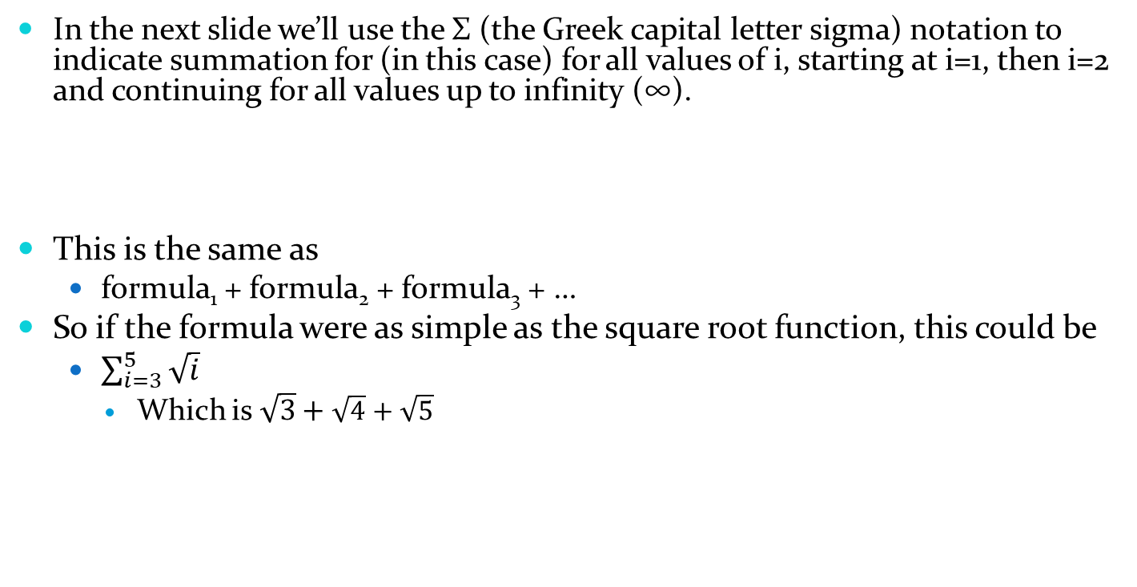
Just a Bit of Symbology
In the next slide we’ll use the Σ (the Greek capital letter sigma) notation to indicate summation for (in this case) for all values of i, starting at i=1, then i=2 and continuing for all values up to infinity (∞).
This is the same as
  formula₁ + formula₂ + formula₃ + …
So if the formula were as simple as the square root function, this could be
  $\sum_{i=3}^{5}{\sqrt{i}}$
    Which is $\sqrt{3}+\sqrt{4}+\sqrt{5}$

Slide 27
How Many Dimensions?!?
Very roughly speaking, the following calculation appeared in the original string theory, where D is the number of dimensions we’re talking about.
  See A First Course in String Theory, Barton Zwiebach, first edition, page 230
This calculation evaluated to ±∞, unless D = 26!
String theory predicts the number of dimensions!
This equation came about, in part, by requiring that string theory be consistent with the conditions of both quantum theory and relativity.

Slide 28
Enter Supersymmetry
Remember that the original string theory modeled only bosons, not fermions.
The concept of supersymmetry (SUSY) proposed a hitherto unsuspected relationship between the two.
Every boson has a fermion partner, and vice-versa. These are called sparticles.
This doubles the number of particle types in the universe!
  This happened previously when antimatter was discovered.
If supersymmetric particles exist, they will probably (hopefully!) be detected by the LHC.
  Stay tuned, maybe…
Sparticles are candidates for dark matter.

Slide 29
Particles and Sparticles
Normal Particle | Superparticle
Electron | Selectron
Quark | Squark
Top Quark | Stop Squark (I kid thee not!)
Higgs boson | Higgsino
Photon | Photino
Graviton | Gravitino
W particle (Weak force carrier) | Wino (sorry, but this is pronounced “weeno”)
etc

Slide 30
Failure then Success
Superstring theory was at first snubbed by most physicists.
It didn’t really describe our universe that well.
In particular, some of its basic formulas predicted infinite values.
But in 1984, in what’s termed “The First Superstring Revolution”, Michael Green and John Schwarz resolved some of the worst mathematical problems.
Suddenly, there was a lot of interest in the theory.

Slide 31
There and Back Again
So in theory we can turn a particle/sparticle into a sparticle/particle and back again.
  For example, an electron can emit a photino and turn into a selectron, and vice-versa.
  So we would have: electron → selectron → electron.
And we’re back where we started.
Not quite!
The original electron will now be shifted in space.
Is there a tie-in to gravity here? Maybe.

Slide 32
Superstring Theory
Merging the concept of supersymmetry into the original string theory produced what we now call superstring theory.
So, technically, string theory ≠ superstring theory.
But since the original string theory is essentially passé, we now normally just refer to string theory but mean superstring theory.

Slide 33
We’re Doing Better(?)
With the Number of Dimensions
Whereas the original string theory required 26 dimensions, superstring theory requires only 10.
  i.e. the updated equations in superstring theory are consistent only if D = 10.
This is an improvement???
This is an improvement!!!
  Well, maybe somewhat better, at least.
    Sorta
      Kinda
        …

Slide 34
What Do These Other
Dimensions Look Like?
Kaluza’s original 5th dimension was a simple circle.
String theory requires that the extra 6 dimensions be curled up (“compactified”) in highly specific ways.
The good news is that mathematicians had already investigated these.
They’re called Calabi-Yau spaces.
  Eugenio Calabi and Shing-Tung Yau.

Slide 35
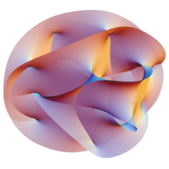
Picture of a Calabi-Yau Space
2-D flattening of 3-D cross-section of 6-D Calabi-Yau space.

Slide 36
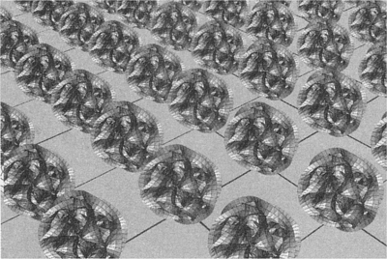
Where Are They?
Answer – At every single point in our normal concept of space.
Shown spaced out, else the picture would be entirely black!

Slide 37
Calabi-Yau Spaces –
What Good Are They?
They’re ultra-small. They’re convoluted. Can’t we just ignore them?
The Standard Model is incomplete. There are some two dozen constants of nature that aren’t predicted by theory and must be put in by hand (i.e. from experimental data). Among others, these include…
  Masses of all the elementary particles (electron, quarks, etc).
  Strengths of forces of nature (electricity, gravitation, etc).
The precise shape of the Calabi-Yau manifold may determine these.
One problem – there may be 10⁵⁰⁰ of them! Maybe even 10¹⁰⁰⁰!!!
  Which may actually turn out to be a good thing!

Slide 38
Calabi-Yau Implication #1
The Universe and Goldilocks
  If the strong nuclear force (that keeps nuclei together) were a few % stronger or weaker, fusion reactions would change and either stars wouldn’t form at all, or they would burn out quickly before life could form on their planets.
  If the charge on the electron were off by a few %, either atoms could not retain electrons, or else electrons would not bond with other atoms. Either way, no molecules.
  And there are other examples. But all say that if the constants of nature were only a few % different, life as we know it would not exist.

Slide 39
The Anthropic Principle
There are several versions of this, but for our purposes, the Anthropic Principle says that…
The laws of nature, and its fundamental constants, must be such as to allow observers such as us to be present.
And as we’ve just seen, there are very tight constraints on this.
So why is the universe so fine-tuned?

Slide 40
Calabi-Yau to the Rescue!
There is reason to believe that at the Big Bang, multiple universes were created – a Multiverse!
In any given universe, all points would have the same Calabi-Yau shape.
But different universes could have different Calabi-Yau shapes, and thus different laws of physics with different constants of nature.
So the vast majority of these universes are probably sterile.
But by the Anthropic principle, it’s no surprise that we’re in one of the relatively few universes that are fine-tuned for life.

Slide 41
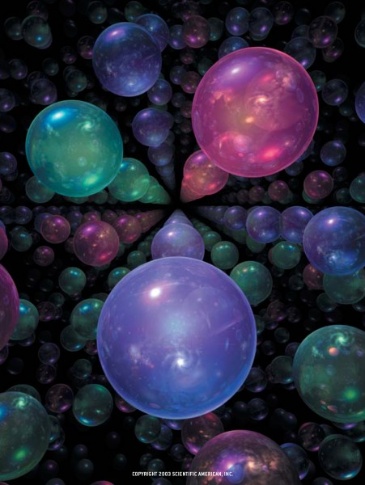
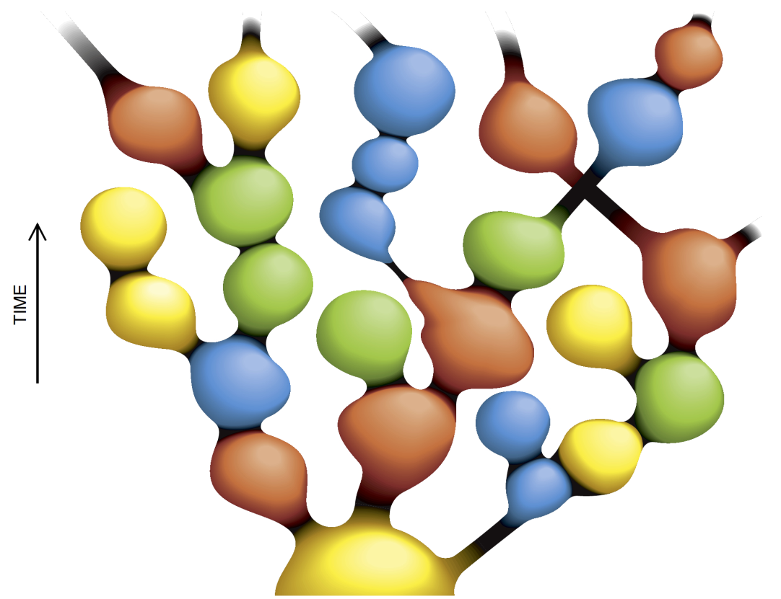
The Multiverse

Slide 42
Calabi-Yau Implication #2
Hol(e)y Calabi-Yau!
Matter seems to come in 3 families (also known as generations).
  Electrons, muons and tau particles
    Each with their associated neutrinos.
  Up/Down, Strange/Charm, Top/Bottom quarks.
A Calabi-Yau space with 3 (multidimensional) holes could explain this.
For example, Andrew Strominger and Ed Witten have shown that the masses of particles depend on the manner of the intersection of the various holes in a Calabi–Yau space.

Slide 43
String Theory : Generations
Each of the first 3 columns is a family.
The 4th column shows the particles of force.
Other particles are made up of quarks (e.g. the proton = uud).
Missing – antiparticles, the Higgs boson(s), the graviton, sparticles and maybe others.
Notes:
Should we take a break here?

Slide 44
The Elephant in the Room
String theory is fairly new, its predecessor having first been proposed in the late 1960’s, and only as a theory of the strong nuclear force.
Its mathematics is very advanced, but, to those able to understand it, it’s very beautiful. And physics has a history of being predicted by beautiful mathematics and only later found experimentally. For example,
  Paul Dirac’s math predicted antimatter in 1928, and the positron was found four years later
  Einstein’s General Theory of Relativity in 1916 predicted gravitational waves, which weren’t detected until 100 years later!
  The Higgs boson was predicted in 1964 but wasn’t detected until 2012.
For more math, search for John Baez Octonions.
  Side note: He’s Joan’s cousin!
But do we have any experimental evidence?

Slide 45
Do we have any experimental evidence?
The short answer is “No”.
In particular, the LHC has seen no explicit indication of supersymmetry. But then again, it hasn’t ruled it out.
According to Scientific America, July 2002, Uncovering Supersymmetry, the answer may be “Yes” (sort of).

Slide 46
Perhaps a Hint…
Remember, pairs of fermions can be treated as a boson.
The nucleus of an atom, especially with a large number of nucleons, is a very busy place, and hard to model.
Nuclei with an odd number of nucleons can be considered to consist of n bosons + 1 fermion.
In 1980, Francesco Iachello of Yale proposed using supersymmetry to relate a nucleus with n bosons and 1 fermion to one with n+1 bosons.
Experiments during the 1980’s found hints of supersymmetry, but couldn’t confirm this idea unambiguously.
But in 1989, this theory was able to predict properties of Gold-186 that closely matched experimental evidence.
“The agreement between theory and experiment, though not exact, is impressive for such a complicated nuclear system.”
  Scientific American, op. cit. page 74.

Slide 47
Electroweak Unification
We’ve known since Maxwell’s 1873 paper that Electricity and Magnetism are two sides of the same coin and are thus unified.
The 1979 Nobel prize in Physics was awarded for showing that Electromagnetism and the Weak Force were also unified. While seeming to be different at low energies, above the unification energy they merge into a single force.
From https://en.wikipedia.org/wiki/Electroweak_interaction, “Although these two forces appear very different at everyday low energies, the theory models them as two different aspects of the same force. Above the unification energy, on the order of 246 GeV, they would merge into a single force.”
Going backwards, we think that at the Big Bang, there was only one force, which, as the universe cooled, broke into seemingly different forces.

Slide 48
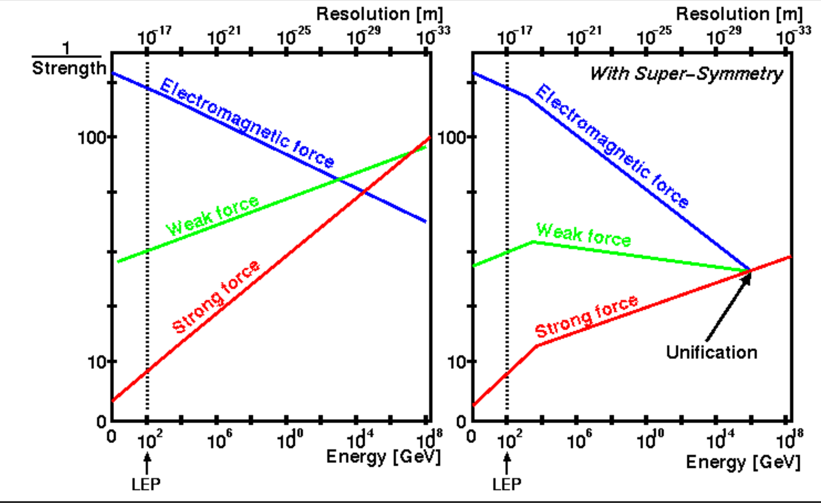
Grand Unification Energy
If you extrapolate where our non-gravitational forces meet, you’ll get the graph on the left. They don’t quite mesh.
But if you assume that Supersymmetry is true, they do meet!
https://www.bing.com/images/search?view=detailV2&ccid=1dY0cCGZ&id=EC859002677AFC2D83801C33D15FF34C892C2965&thid=OIP.1dY0cCGZoCUHx_cyfPtJKQHaEh&mediaurl=https%3a%2f%2fi.stack.imgur.com%2fUr0ol.gif&cdnurl=https%3a%2f%2fth.bing.com%2fth%2fid%2fR.d5d634702199a02507c7f7327cfb4929%3frik%3dZSksiUzzX9EzHA%26pid%3dImgRaw%26r%3d0&exph=453&expw=742&q=supersymmetry+physics+unification&simid=607995978586073270&FORM=IRPRST&ck=F291DCB8C9FE291C50EB41149576C84D&selectedIndex=1&ajaxhist=0&ajaxserp=0

Slide 49
Suggested Reading
Warped Passages, by Lisa Randall.
  She was the first tenured woman in the Princeton University physics department and the first tenured female theoretical physicist at MIT and Harvard University.
  Her specialty is creating mathematical models of new concepts in physics, often involving higher dimensions.
  Watch the video of her being interviewed on PBS by Charlie Rose at https://www.bing.com/videos/search?q=charlie+rose+lisa+randall&docid=608053191829829065&mid=29346367960FABEA3CE529346367960FABEA3CE5&view=detail&FORM=VIRE

Slide 50
Suggested Reading /Viewing
The Elegant Universe, by Brian Greene.
  A very readable introduction to modern string theory. It gets a bit technical when he talks about his (to him) big discovery, but you forgive a lot when the rest of the book is this good.
The Fabric of the Cosmos, by Brian Greene.
  Like his previous book, but not limited to just string theory.
https://www.youtube.com/watch?v=YtdE662eY_M
https://www.bing.com/videos/search?q=Nova+Elegant+Universe&FORM=VDMHRS

Slide 51
Suggested Reading
  The Road to Reality, by Sir Roger Penrose.
    At over 1,000 pages, this is an absolutely amazingly comprehensive book on practically all aspects of particle physics, cosmology, quantum mechanics and more.
    There’s lots of readable prose, but there’s also a lot of mathematics thrown in for those who can handle it.
    But even if you can’t hack the math, there are enough fascinating nuggets in the prose that it’s a treasure trove of information for the physics enthusiast.
    Chapter 31 is entitled “Supersymmetry, supra-dimensionality and strings”.

Slide 52
Suggested Reading
  Flatland, by Edwin A. Abbot
    A classic, written in 1884. It tries to help us (more or less) 3-dimensional beings understand the 4th dimension by imagining how a 2-D being might envision a 3-D world.
  Sphereland, by Dionys Burger
    A pastiche sequel to Flatland, written in 1965.
    Set in Flatland, it introduces us to the concept of curved space (e.g. their scientists find out that the sum of the angles in a triangle is > 180º).

Slide 53
Suggested Reading/Viewing
The Cosmic Landscape (String Theory and the Illusion of Intelligent Design), by Leonard Susskind.
  Susskind is one of the originators of string theory. In this book he talks widely about extra dimensions, Calabi-Yau spaces, branes, the Anthropic Principle, etc, etc, etc.
    YouTube has many of Susskind’s lectures at Stanford. Just search it for Susskind. Note that most of these are university-level lectures, but you can probably get some ideas from them.
    His lectures are also available on iTunes.
    See https://www.youtube.com/playlist?list=PL6i60qoDQhQGaGbbg-4aSwXJvxOqO6o5e for a list of them, including 10 lectures on String Theory and M-Theory

Slide 54
Suggested Reading
The Shape of Inner Space: String Theory and the Geometry of the Universe's Hidden Dimensions, by Shing-Tung Yau.
  As in Calabi-Yau
  Not the best written popular science book I’ve ever read. Probably best obtained from the library.

Slide 55
Suggested Reading
The Trouble With Physics, by Lee Smolin
  The other point of view. There are other candidates for a quantum theory of gravity (such as Causal Dynamic Triangulations and Smolin’s own Loop Quantum Gravity), which need only 4 dimensions.
  This book explores the weaknesses of string theory and criticizes the academic world for being too “faddish” on the subject, and discouraging research into alternatives.
  As with all (well, most) of Smolin’s books, it’s well written and interesting.

Slide 56
This Presentation
You can find it at http://lrs5.net/FTPData/Science/

Slide 57
Thank You

