Slide 1
No, E Does NOT Equal mc² and I’ll Show You Why!

Slide 2
Dedication
To the memory of Stephen Hawking
January 8th, 1942
to
March 14, 2018
Perhaps the universe itself lauded him.
He was born on the 300th anniversary of Galileo’s death,
and he died on π day (3 / 14),
which was also Einstein’s birthday!

Slide 3
Questions
I’m quite open to questions during the presentation. But…
We’ve got a lot to get through, and a limited time to do so in, so if things even start to get out of hand, I may have to be firm and cut off the discussion.
There are around 60 slides, which allows me about 2 minutes per slide, even without questions. Time will be tight.
Again, for time constraint reasons, I’ll accept only questions that boil down to “I don’t understand”, “could you go over that again” and so on. If any other types of questions are asked, I’ll have to be curt and say that we have to defer the question.
When the presentation is over, if we have any time left, then the field will be open to any questions.

Slide 4
Confession Time
This talk really should have been titled
A Technical Introduction to Special Relativity
But with a title like No, E Does NOT Equal mc² and I’ll Show You Why!, well, if that didn’t convince you to come to this presentation, nothing would! ☺
Hawking, in his introduction to A Brief History of Time, said that he was advised that every equation in his book would cut his sales in half. He hoped that E=mc² could sneak by.
But without the equations you can’t really understand Relativity. So it’s my goal to descend from a 10,000 meter overview of the subject into something that can really describe what’s going on.

Slide 5
My Credentials

Slide 6
My Credentials
In other words, I have none.
I’m not a physicist. I’m just a computer nerd who likes math and fundamental physics.
So while I believe that what I’m about to talk about is true, you should probably take it cum grano salis.

Slide 7
Bibliography and Links
I used to put this at the end of the presentation, but after the last slide, I never got to present these. So here they are at the front.
Albert Einstein
  On the Electrodynamics of Moving Bodies (June 30, 1905) – http://www.fourmilab.ch/etexts/einstein/specrel/www/
  Does the Inertia of a Body Depend upon its Energy-Content? (September 27, 1905) – http://users.physik.fu-berlin.de/~kleinert/files/e_mc2.pdf
Special Relativity in Wikipedia
  https://en.wikipedia.org/wiki/Special_relativity
  https://en.wikipedia.org/wiki/Special_relativity#Time_dilation
  https://en.wikipedia.org/wiki/Special_relativity#Length_contraction
  https://en.wikipedia.org/wiki/Special_relativity#Composition_of_velocities
  https://en.wikipedia.org/wiki/Relativistic_Doppler_effect
  https://en.wikipedia.org/wiki/Planck%E2%80%93Einstein_relation

Slide 8
Bibliography and Links
Mr. Tompkins books by George Gamow
  https://www.amazon.com/s/ref=nb_sb_noss_2?url=search-alias%3Daps&field-keywords=Mr.+Tompkins&rh=i%3Aaps%2Ck%3AMr.+Tompkins
Associated videos
  Feynman – How did we find the speed of light – https://www.youtube.com/watch?v=b9F8Wn4vf5Y
  Sagan – Speed of light constant – https://www.youtube.com/watch?v=_pEiA0-r5A8
Special Relativity and Classical Field Theory – https://www.amazon.com/Special-Relativity-Classical-Field-Theory/dp/0465093345/ref=sr_1_3?ie=UTF8&qid=1521837735&sr=8-3&keywords=leonard+susskind
  Other excellent Susskind books – https://www.amazon.com/s/ref=nb_sb_noss_2?url=search-alias%3Daps&field-keywords=leonard+susskind&rh=i%3Aaps%2Ck%3Aleonard+susskind

Slide 9
Special vs. General Relativity
When I was young, I thought that the “General” in General Relativity referred to something rather vague, just sort of hand-wavy (wibbly-wobbly, timey-wimey?), as in “generally speaking”. Whereas Special Relativity was, oh boy, something really special.
WRONG!
Special Relativity was created first because Einstein couldn’t analyze motion in general. But he could understand the special case of particles that do not change speed or direction. These are called inertial frames where bodies (in the absence of other forces like friction) just continue to coast along through inertia, same speed, same direction.
General Relativity is a much more sophisticated theory, allowing us to analyze particles that can slow down, can speed up, can dart off in arbitrary directions, and in general constantly curve.
In this presentation, the term “Relativity” by itself always means “Special Relativity”.

Slide 10
Where We’re Going
We’ve all heard that under Special Relativity time and space are not what we normally expect. (We’ll go into that later.)
So after a number of preliminaries, we’re going to consider a particle traveling inertially (at constant speed and direction) from two points of view.
  Alice is traveling nearby along with the particle, so that to her it seems at rest.
  Bob is viewing it while traveling at some velocity v. But he can view himself at rest with our particle travelling at velocity v in the other direction.
  The kinetic energy (energy of motion) of the particle will be zero in the first case, but non-zero in the second case.
To reconcile these two views, we’ll see that there’s an interplay between energy and mass.

Slide 11
The Assumptions of Special Relativity
The laws of nature are the same for all observers in uniform motion (i.e. constant speed and direction – this includes being at rest) relative to one another. (Galileo knew this.)
The speed of light is always measured to be the same for all observers, regardless of their relative motion or the motion of the light source.
  “The principle of the constancy of the velocity of light is of course contained in Maxwell’s equations [for electromagnetism]” – Albert Einstein, Does the Inertia of a Body Depend on its Energy-Content?, September 27, 1905.
  Very loosely speaking, Maxwell’s equations are formulated in terms of electric/magnetic fields and how they change (differential equations, for those who know calculus). This has the subtle side effect of requiring that the speed of electromagnetic energy (i.e. light) must always be measured to be the same.

Slide 12


Vocabulary:
Beta ($\text{b}$) and Especially Gamma (γ)
We’ll need the ratio of a velocity v compared to the speed of light c (from the Latin celeritas – speed).
Physicists call this $\text{b}$ (beta) = $\frac{v}{c}$.
Which is turn leads to one of the most common and important calculations in Special Relativity called γ (gamma), which is
γ = $\frac{1}{\sqrt{1−{\text{b}}^{2}}}$ = $\frac{1}{\sqrt{1−\frac{v^{2}}{c^{2}}}}$
Note that if v < c (i.e. slower than the speed of light) then the denominator is less than one, so its reciprocal is greater than 1.
  γ > 1

Slide 13

Mathematical Preliminaries
γ can also be expanded into the sum of an infinite series of terms using the Binomial Theorem (see Appendix B).
$\text{g}=1+ \frac{1}{2}{\text{b}}^{2}+ \frac{3}{8}{\text{b}}^{4}+ \frac{5}{16}{\text{b}}^{6}+\frac{35}{128}{\text{b}}^{8}+\frac{63}{256}{\text{b}}^{16}+ …$
For details on how these two versions of γ are the same, see Appendix B.
For now, please accept that statement that the two versions are the same. In particular, even though the expansion is the sum of an infinite number of positive values, it does converge to a finite value.

Slide 14

γ – The Lorentz Transformation
γ = $\frac{1}{\sqrt{1−{\text{b}}^{2}}}$ = $\frac{1}{\sqrt{1−\frac{v^{2}}{c^{2}}}}$
This is called the Lorentz Transformation.
As we’ll see later, this is the factor that will let us transform Alice’s time into Bob’s time, Alice’s lengths into Bob’s lengths, and so on. And vice versa.
https://en.wikipedia.org/wiki/Lorentz_transformation

Slide 15
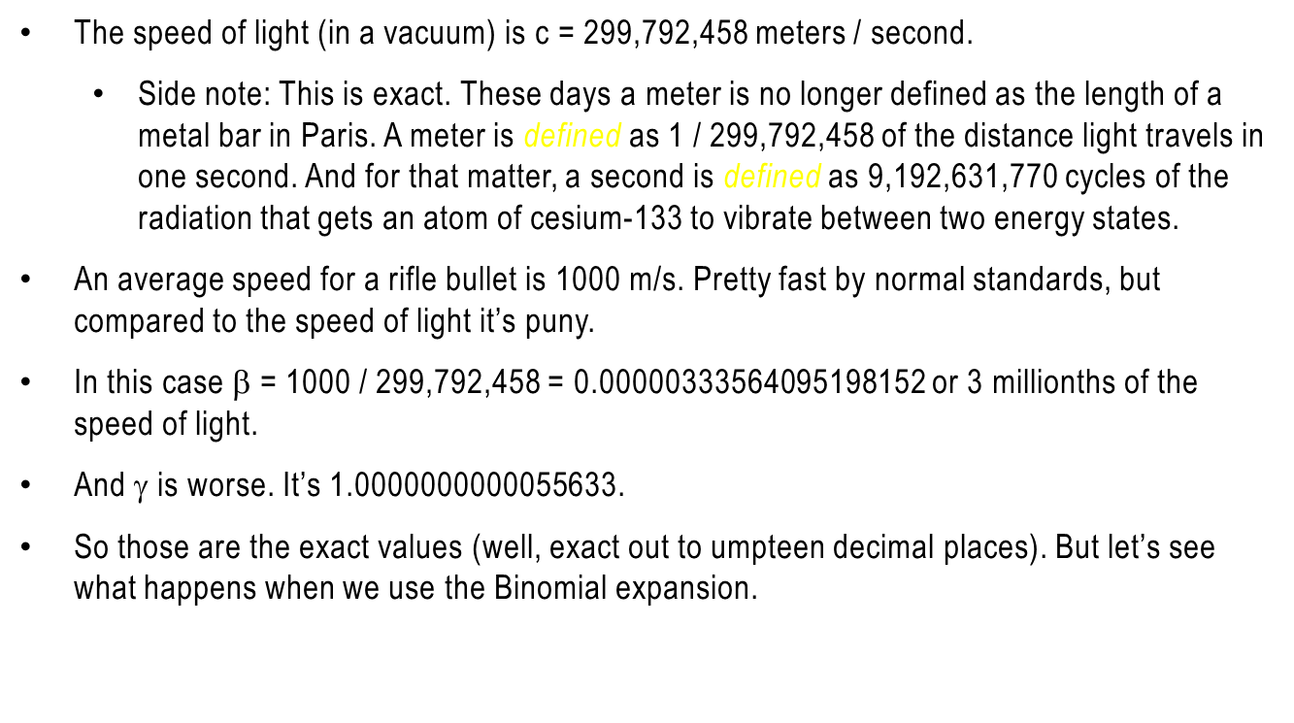
Approximations
The speed of light (in a vacuum) is c = 299,792,458 meters / second.
  Side note: This is exact. These days a meter is no longer defined as the length of a metal bar in Paris. A meter is defined as 1 / 299,792,458 of the distance light travels in one second. And for that matter, a second is defined as 9,192,631,770 cycles of the radiation that gets an atom of cesium-133 to vibrate between two energy states.
An average speed for a rifle bullet is 1000 m/s. Pretty fast by normal standards, but compared to the speed of light it’s puny.
In this case $\text{b}$ = 1000 / 299,792,458 = 0.00000333564095198152 or 3 millionths of the speed of light.
And γ is worse. It’s 1.0000000000055633.
So those are the exact values (well, exact out to umpteen decimal places). But let’s see what happens when we use the Binomial expansion.

Slide 16
The Binomial Approximation of γ
As we’ve seen, the value of γ can be calculated by an infinite series. But the table below shows that even at the speed of 1,000,000 m/sec, it’s extremely accurate to calculate it by using only 2 terms of the series: 1 + β² / 2. So we’ll use that later.
  Einstein did this. In his 1905 paper Does the Inertia of a Body Depend on Its Energy Content?, he said “Neglecting magnitudes of 4th and higher orders…”
Speed (m/sec) | γ (to 10 decimal places) | # of Terms | Value from series | % Difference
1,000 | 1.0000000000 | 2 | 1.0000000000 | 0.00000%
 |  | 3 | 1.0000000000 | 0.00000%
 |  | 4 | 1.0000000000 | 0.00000%
1,000,000 | 1.0000055633 | 2 | 1.0000055633 | 0.00000%
 |  | 3 | 1.0000055633 | 0.00000%
 |  | 4 | 1.0000055633 | 0.00000%

Slide 17
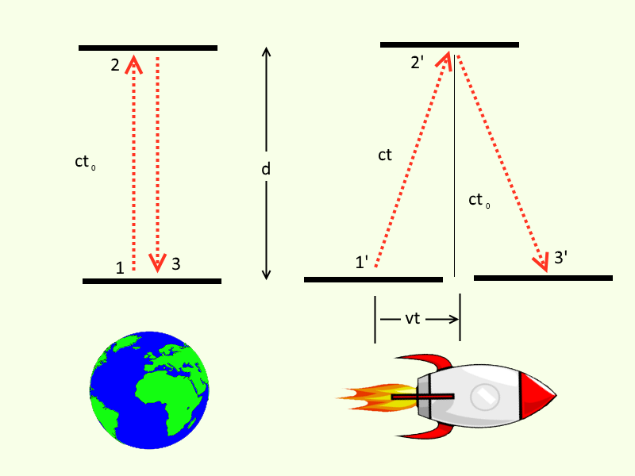
Time Dilation
Imagine the following scenario:
Alice is sitting home on Earth at rest.
Through her telescope she sees Bob’s rocket ship moving left to right at velocity v.
They both have special clocks that are merely two mirrors, one above the other, with a photon bouncing between them. The two clocks are identical with the same height.
Both Alice and Bob see their respective photons bouncing straight up and down. But Alice sees Bob’s photon tracing a zig-zag path, each leg being longer than hers.
In the time it takes Alice’s clock to tick once, Bob’s clock hasn’t had a chance to do so yet.
Bob’s clock is running slower than Alice’s!

Slide 18
What Are the Pieces of the Puzzle?
It takes Alice’s clock some amount of time to go from one mirror to the other. We’ll call this t_{Alice}. Note that in the diagram this is called t₀.
Photons always travel at speed c, so the distance between the plates is ct_{Alice}.
Because Bob’s ship is moving horizontally, vertical distances are not affected, so he measures the distance his photon travels as also ct_{Alice}.
But note that the path of his photon from Alice’s point of view is clearly longer than Alice’s, so it will take longer to reach the top mirror (again, from Alice’s POV). We’ll call this time t_{Bob} (which in the diagram it’s called just t). The distance is ct_{Bob}.
Finally, in the time for it to reach the top, Bob’s ship has traveled vt_{Bob}.

Slide 19
How Much Slower is Bob’s Clock Running?
So what’s the relationship between t_{Alice} and t_{Bob}? We’ll use the Pythagorean Theorem.
It’s clear that (ct_{Bob})² = (ct_{Alice})² + (vt_{Bob})².

Slide 20
How Much Slower is Bob’s Clock Running?
So what’s the relationship between t_{Alice} and t_{Bob}? We’ll use the Pythagorean Theorem.
It’s clear that (ct_{Bob})² = (ct_{Alice})² + (vt_{Bob})².
c²t_{Bob}² = c²t_{Alice}² + v²t_{Bob}²

Slide 21

How Much Slower is Bob’s Clock Running?
So what’s the relationship between t_{Alice} and t_{Bob}? We’ll use the Pythagorean Theorem.
It’s clear that (ct_{Bob})² = (ct_{Alice})² + (vt_{Bob})².
c²t_{Bob}² = c²t_{Alice}² + v²t_{Bob}²
Divide both sides by c²: t_{Bob}² = t_{Alice}² + t_{Bob}² ${\frac{v}{c2}}^{2}$

Slide 22

How Much Slower is Bob’s Clock Running?
So what’s the relationship between t_{Alice} and t_{Bob}? We’ll use the Pythagorean Theorem.
It’s clear that (ct_{Bob})² = (ct_{Alice})² + (vt_{Bob})².
c²t_{Bob}² = c²t_{Alice}² + v²t_{Bob}²
Divide both sides by c²: t_{Bob}² = t_{Alice}² + t_{Bob}² ${\frac{v}{c2}}^{2}$
So t_{Bob}²(1 - ${\frac{v}{c2}}^{2}$) = t_{Alice}²

Slide 23

How Much Slower is Bob’s Clock Running?
So what’s the relationship between t_{Alice} and t_{Bob}? We’ll use the Pythagorean Theorem.
It’s clear that (ct_{Bob})² = (ct_{Alice})² + (vt_{Bob})².
c²t_{Bob}² = c²t_{Alice}² + v²t_{Bob}²
Divide both sides by c^{2:} t_{Bob}² = t_{Alice}² + t_{Bob}² ${\frac{v}{c2}}^{2}$
So t_{Bob}²(1 - ${\frac{v}{c2}}^{2}$) = t_{Alice}²
Dividing and taking the square root we have finally
t_{Bob} = t_{Alice} ($\frac{1}{\sqrt{1 − \frac{v^{2}}{c^{2}}}}$) = t_{Alice} γ
So to get Bob’s time (in his moving ship), we multiply Alice’s (at rest) time by γ.
And to convert Bob’s time to Alice’s, we’d just divide by γ.

Slide 24

The Bottom Line
Again: t_{Bob} = t_{Alice} ($\frac{1}{\sqrt{1 − \frac{v^{2}}{c^{2}}}}$) = t_{Alice} γ
Or: t_{Alice} = t_{Bob} / γ
What is this telling us? Note that v is always less than c (you can’t travel faster than light (Star Trek et al notwithstanding)).
So if γ is, say, 2 (which happens when v is about 86.6% the speed of light), then t_{Bob} = 2 * t_{Alice}
So for every tick of Bob’s clock, Alice’s ticks twice!
Bob’s clock ticks twice as slowly as Alice’s does.
But he doesn’t notice anything different! His clock’s traveling at speed v, but so is he, with his photon still bouncing straight up and down!

Slide 25
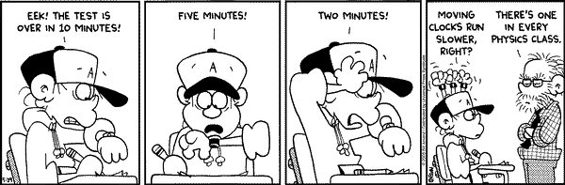
Whew! Let’s Give Our Brains a Break

Slide 26
An Act of Desperation
In 1900, Max Planck was faced with a dilemma. There were two formulas that predicted what color light (i.e. frequency) an object (e.g. a piece of metal) emitted when heated. But neither was right. One worked well for low frequencies but not high ones, and the other was good for high frequencies only.
He tried everything he could think of, but couldn’t deduce what the correct formula was. Finally, in what he termed an “act of desperation”, he assumed that energy could not take on all continuous values, but could only exist in discrete steps. This led to the correct formula for all frequencies.
Thus was born Quantum Mechanics.
The energy of light of frequency f is hf where h is Planck’s constant.
  Note: Physicists often use the Greek letter ν (nu) for frequency, so you might also see this written as E = hν.
https://en.wikipedia.org/wiki/Planck%E2%80%93Einstein_relation

Slide 27

Relativistic Quantum Mechanics
Here we need to introduce a concept, not just from Quantum Mechanics, but from Special Relativity as it applies to Quantum Mechanics.
While we’re here, Let’s talk just a bit about Planck’s constant. It has an extremely small value of around 10⁻³⁴ Joule seconds, which explains why it normally needs to be considered only in atoms and smaller. But we don’t need to use this value in this presentation.
Frequency is defined as the number of wavelengths per unit time. (Uh-oh, the “t” word!)
But Time Dilation tells us that time varies with velocity. So the energy must be Lorentz transformed, meaning that E must be corrected to (using our Binomial Expansion Approximation)
  E * $\left(1+ \frac{v^{2}}{2c^{2}}\right)$ The Relativistic Doppler Effect
https://en.wikipedia.org/wiki/Relativistic_Doppler_effect

Slide 28

OK, Enough Preliminaries!
The Setup
Imagine an object T (for thing) floating alone in intergalactic space (i.e. no appreciable forces acting on it). It has rest mass m.
Imagine that Alice is at rest relative to T (e.g. just floating next to T).
And that Bob is in a spaceship moving at constant relative velocity v to the left of T (so that from Bob’s point of view, T appears moving to his right).

Slide 29

Let There Be Light!
Some time later, T simultaneously emits two identical photons in opposite directions for a total energy loss of E, with each photon having energy E/2.
So because of conservation of energy, T’s energy has now diminished by E.
Because the photons are equal in energy and heading in opposite directions, T doesn’t move, so it doesn’t change position from either Alice’s or Bob’s point of view.

Slide 30
Let’s Calculate the Energy of T in Two Ways
Alice’s Way
Before the flash: From her POV, T isn’t moving and thus has 0 kinetic energy.
So Energy_{Alice} = KE_{Alice} = 0
  Note that this is the kinetic energy of T, not of Alice, but it’s the kinetic energy of T from Alice’s point of view.
After the flash, T now has energy Energy_{Alice} = KE_{Alice} – E = -E

Slide 31

Let’s Calculate the Energy of T in Two Ways
Bob’s Way
Before the flash: Since T is moving, it has a certain amount of kinetic energy. Call this KE_{Bob} (again this is the kinetic energy of T, not of Bob, but it’s the kinetic energy from Bob’s point of view).
This is just $\frac{1}{2}mv^{2}$, where m is the mass of object T and v is T’s velocity relative to Bob.

Slide 32

Let’s Calculate the Energy of T in Two Ways
Bob’s Way
Before the flash: Since T is moving, it has a certain amount of kinetic energy. Call this KE_{Bob} (again this is the kinetic energy of T, not of Bob, but it’s the kinetic energy from Bob’s point of view).
This is just $\frac{1}{2}mv^{2}$, where m is the mass of T and v is T’s velocity relative to Bob.
After the flash it’s lost energy E, so its energy is
  Energy_{Bob} = $\frac{1}{2}mv^{2}$ – E

Slide 33

Let’s Calculate the Energy of T in Two Ways
Bob’s Way
Before the flash: Since T is moving, it has a certain amount of kinetic energy. Call this KE_{Bob} (again this is the kinetic energy of T, not of Bob, but it’s the kinetic energy from Bob’s point of view).
This is just $\frac{1}{2}mv^{2}$, where m is the mass of T and v is Bob’s velocity relative to T.
After the flash it’s lost energy E, so its energy is
  Energy_{Bob} = $\frac{1}{2}mv^{2}$ – E
But wait, as we saw earlier, under Relativity, the frequency of the energy must change. So according to the Relativistic Doppler Effect its energy is actually
  Energy_{Bob} = $\frac{1}{2}mv^{2}$ –$E\left(1+ \frac{v^{2}}{2c^{2}}\right)$

Slide 34

Who’s Right – Alice or Bob?
So Alice thinks T has energy –E
Bob sees T having energy $\frac{1}{2}mv^{2}$ –$E\left(1+ \frac{v^{2}}{2c^{2}}\right)$
But we’ve never touched T, just observed it from a distance, neither added to nor subtracted from T’s total energy.
So the two expressions must somehow give the same result. How do we reconcile the two?
In other words, –E = $\frac{1}{2}mv^{2}$ –$E\left(1+ \frac{v^{2}}{2c^{2}}\right)$

Slide 35

Alice and Bob Reconcile
(Isn’t that sweet?)
So we have:
–E = $\frac{1}{2}mv^{2}$ –$E\left(1+ \frac{v^{2}}{2c^{2}}\right)$

Slide 36

Alice and Bob Reconcile
So we have:
–E = $\frac{1}{2}mv^{2}$ –$E\left(1+ \frac{v^{2}}{2c^{2}}\right)$
–E = $\frac{1}{2}mv^{2}$ –$E−E\frac{v^{2}}{2c^{2}}$

Slide 37

Alice and Bob Reconcile
So we have:
–E = $\frac{1}{2}mv^{2}$ –$E\left(1+ \frac{v^{2}}{2c^{2}}\right)$
–E = $\frac{1}{2}mv^{2}$ –$E−E\frac{v^{2}}{2c^{2}}$
0 = $\frac{1}{2}mv^{2}$ $− E\frac{v^{2}}{2c^{2}}$ (the –E’s on both sides cancel)

Slide 38

Alice and Bob Reconcile
So we have:
–E = $\frac{1}{2}mv^{2}$ –$E\left(1+ \frac{v^{2}}{2c^{2}}\right)$
–E = $\frac{1}{2}mv^{2}$ –$E−E\frac{v^{2}}{2c^{2}}$
0 = $\frac{1}{2}mv^{2}$ $− E\frac{v^{2}}{2c^{2}}$ (the –E’s on both sides cancel)
E$\frac{v^{2}}{2c^{2}}$ = $\frac{1}{2}mv^{2}$

Slide 39

Alice and Bob Reconcile
So we have:
–E = $\frac{1}{2}mv^{2}$ –$E\left(1+ \frac{v^{2}}{2c^{2}}\right)$
–E = $\frac{1}{2}mv^{2}$ –$E−E\frac{v^{2}}{2c^{2}}$
0 = $\frac{1}{2}mv^{2}$ $− E\frac{v^{2}}{2c^{2}}$ (the –E’s on both sides cancel)
E$\frac{v^{2}}{2c^{2}}$ = $\frac{1}{2}mv^{2}$
$\frac{E}{c^{2}}$ = $m$ (the $\frac{1}{2}v^{2} terms cancel)$

Slide 40
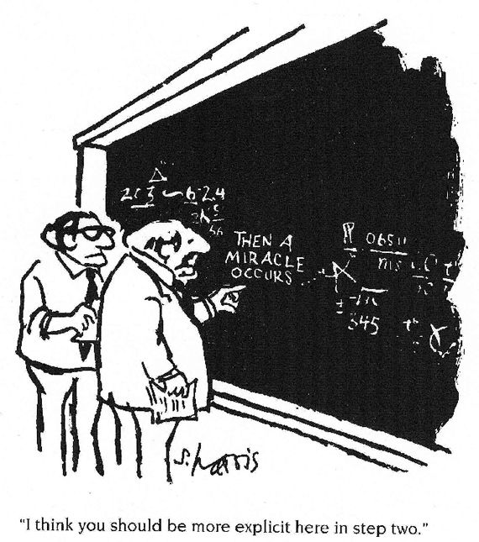

Alice and Bob Reconcile
So we have:
–E = $\frac{1}{2}mv^{2}$ –$E\left(1+ \frac{v^{2}}{2c^{2}}\right)$
–E = $\frac{1}{2}mv^{2}$ –$E−E\frac{v^{2}}{2c^{2}}$
0 = $\frac{1}{2}mv^{2}$ $−E\frac{v^{2}}{2c^{2}}$(the –E’s on both sides cancel)
E$\frac{v^{2}}{2c^{2}}$ = $\frac{1}{2}mv^{2}$
$\frac{E}{c^{2}}$ = $m$ (the $\frac{1}{2}v^{2} terms cancel)$
E = $mc^{2}$ (TADA!)

Slide 41
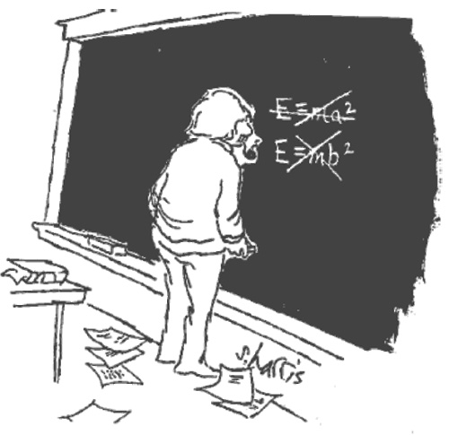
WAIT A MINUTE!
I thought the point of this presentation was to show that E was NOT equal to mc² !!!!!!!!!!
But the argument we used was essentially the one Einstein used.
So where did he go wrong? Any guesses?

Slide 42
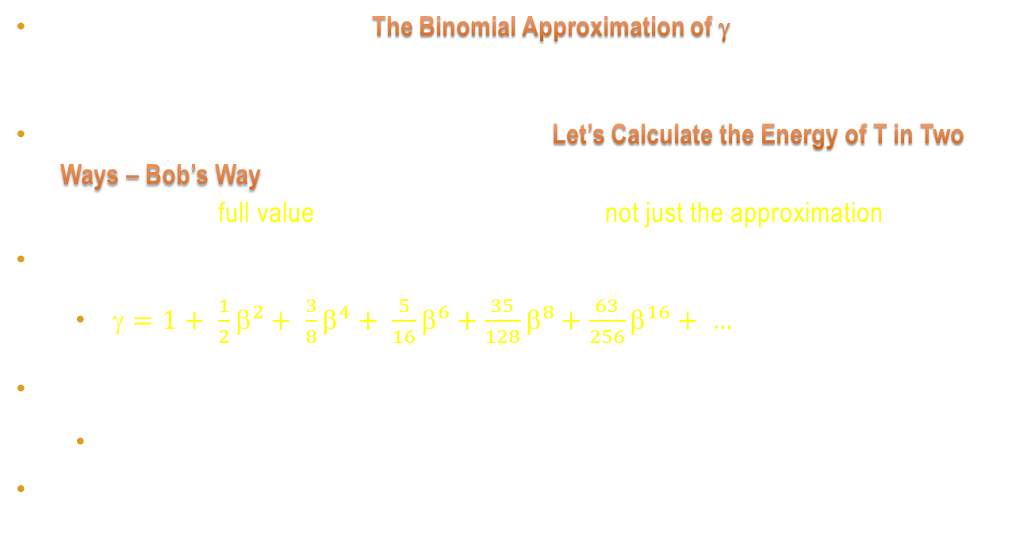
Einstein’s “Mistake”
Some 30 or so slides ago, in The Binomial Approximation of γ, I showed that even at a speed of 1,000,000 km/sec, we got an excellent approximation to γ by using just 2 terms of the binomial expansion. Which is what Einstein used.
But that was only an approximation. So in the Let’s Calculate the Energy of T in Two Ways – Bob’s Way slide, instead of writing Energy_{Bob} = $\frac{1}{2}mv^{2}$ –$E\left(1+ \frac{v^{2}}{2c^{2}}\right)$, I should have used the full value of γ’s binomial expansion, not just the approximation.
So the true equation is really (with β = v/c) and
  $\text{g}=1+ \frac{1}{2}{\text{b}}^{2}+ \frac{3}{8}{\text{b}}^{4}+ \frac{5}{16}{\text{b}}^{6}+\frac{35}{128}{\text{b}}^{8}+\frac{63}{256}{\text{b}}^{16}+ …$
Energy_{Bob} = $\frac{1}{2}mv^{2}$ –$E(1+\frac{v2}{2c2} + \frac{3}{8}$ $\frac{v^{4}}{c^{4}}$ + …)
  Here’s where Einstein said “Neglecting magnitudes of 4th and higher orders…”
And using the full expansion would lead to E = mc² + {other terms}

Slide 43

Let’s Do It Right
–E = $\frac{1}{2}mv^{2}$ –$E(1+\frac{v2}{2c2} + \frac{3}{8} \frac{v^{4}}{c^{4}}\text{ + …)}$
–E = $\frac{1}{2}mv^{2}$ –$E−E\frac{v^{2}}{2c^{2}}$ $−E\frac{3v4}{8c4}−$ …
0 = $\frac{1}{2}mv^{2}$ $−E\frac{v^{2}}{2c^{2}}−E\frac{3v4}{8c4}−$ … (the –E’s on both sides cancel)
E $\frac{v^{2}}{2c^{2}}$ $−E\frac{3v4}{8c4}−$ … = $\frac{1}{2}mv^{2}$
$\frac{E}{c^{2}}$ $−E\frac{3v2}{8c4}−$ … = $m$ (the $\frac{1}{2}v^{2} terms cancel)$
E = mc² + m$\frac{3v2}{8c2}$ + … (The Right Equation!)

Slide 44

Bottom Line
E = mc² + m$\frac{3v2}{8c2}$ + … (The Right Equation!)
So this is why I say that E doesn’t equal mc². It’s just an approximation.
  Note that we can’t just let v = 0 since we previously divided by v² and you can’t divide by zero.
  But as v gets closer and closer to 0, the extra terms get arbitrarily close to zero (mathematicians call this in the limit) and the effect of the extra terms melts away.
So in his Does the Inertia of a Body Depend on Its Energy Content? paper, Einstein knew, and knew his audience knew, that the extra terms were there and that, in the limit, E = $mc^{2}$ is true only for the special case of a body at rest (v = 0).
So he just didn’t need to spell it out in gory detail.
But in hindsight it makes sense. If a body is in motion (v > 0), then it has extra (kinetic) energy, so of course E = mc² + {extra}.

Slide 45
Appendix A
Additional Special Relativity Features
The next few slides describe features of Special Relativity that are interesting, but otherwise weren’t needed in this presentation.
But I assume you’ve heard of many/most of them, and while we’re here I wanted to at least have one slide each on them.
But since this presentation has been long enough as it is, I won’t prove all of them, but will offer some hints or links to web articles that will talk about them, and try to leave some time at the end of the talk for questions. Still, what we’ve talked about so far hopefully should give you a running start on understanding these aspects.

Slide 46

Length Contraction
Perhaps one of the first physics equations you ever learned was
  d = vt (Distance = Velocity * Time)
But as we’ve seen, Time is somewhat fluid. So the proper equation is actually
  d_{Bob} = vt / ($\frac{1}{\sqrt{1 − \frac{v^{2}}{c^{2}}}}$) = vt / γ From Alice’s point of view
And with γ always greater than 1, the length of something decreases the faster it moves.
So if Alice sees Bob travelling at 86.6% of c, she sees him and his whole ship shrunk to half their at-rest size.
This doesn’t mean that as Bob moves faster, it feels like a vise is trying to crush him. Bob would feel absolutely normal.
  Time would seem to him unchanged (since, to him, his clock is bouncing straight up and down).
  His body dimensions would seem the same to him (since his ruler has been foreshortened).
For example, at particle accelerators (e.g. CERN), if a proton is moving at almost the speed of light, it must be modeled not as a sphere but as a pancake. But the proton “thinks” it’s still a sphere.

Slide 47
Batter Up!
Suppose someone is on a train moving at 100 km/hr, and can throw a baseball at 80 km/hr.
You’re at rest on the ground and see the baseball thrown towards the front of the train. What speed would you measure the baseball to be travelling?
180 km/hr, right? Actually, no. This comes out to 179.99999999998397 km/hr. See the next slide.
Now imagine shining a flashlight towards the front of the train. Since realistic speeds are peanuts compared to the speed of light, let’s imagine the train moving at 100 km/second, and the light from the flashlight is, of course, moving at the speed of light, about 300,000 km/sec.
You’d measure the light to be moving at 300,100 km/sec, right?
Wrong! Maxwell’s equations say that you always measure the speed of light to be the same.

Slide 48

Adding Velocities
Remember that velocity is distance / time. But we’ve seen that both distance and time are rather flexible. So maybe it won’t surprise you that velocity isn’t as simple as we’ve traditionally thought.
The proof is a bit complex, so I’ll just sketch things. Search for <relativity velocity addition>.
But the idea behind the formula uses the Lorentz contraction twice, once for distance, once for time.
If you have two objects travelling at speeds u and v (e.g. our 100 km/hr train and our 80 km/hr baseball), their combined speed will not be 180 km/hr. The formula is
$u+v$ = $\frac{u+v}{1+\frac{uv}{c2}}$ (or $u−v$ = $\frac{u−v}{1−\frac{uv}{c2}}$ if the objects are heading towards each other)
Plug u = c into the formula above (e.g. for the flashlight example) and any value of v will give the answer c. This confirms Maxwell’s assertion that the speed of light is the same in all inertial frames.
http://math.ucr.edu/home/baez/physics/Relativity/SR/velocity.html (Side note: John Baez is Joan’s cousin!)

Slide 49
Mass Increases With Velocity
From high-school physics, momentum = mass * velocity
  p = mv
Momentum can be large if the mass is large but the velocity is small (e.g. a freight train slowly wending its way). Or it can be large if the mass is small but the velocity is large (e.g. a rifle bullet). Or some combination of the two.
Basically, momentum tells us how resistant to acceleration something is.
As we now know, whenever we see v (velocity) in a formula, relativity tells us that it really should be γv. So it’s really p = γmv. Let’s write this as p = (γm)v
Since γ > 1, the faster the velocity, the effective mass (“relativistic mass”) increases. So the momentum increases and it makes it harder to accelerate the object. And as v approaches c, γ tends towards infinity and it would require an infinite amount of energy to reach light speed.
https://www.youtube.com/watch?v=LTJauaefTZM
https://www.youtube.com/watch?v=A2JCoIGyGxc

Slide 50
Spacetime
Here’s an argument that might make some aspects of Relativity a bit more intuitively plausible.
Imagine being in a car on a large Utah salt flat. You’re at point A, due south of point B, say, 1 kilometer away. Your car always drives at the same speed, say, 100 km/hour.
Point C is, say, 10 km to the East of B.
You can drive your car directly from A to B. This takes the least amount of time, but you don’t travel any distance East.
You can drive your car (at 100 km/hr) from A to C. You’ll spend more time, but you’ll cover more distance Eastward.
Spacetime is like this. You can stick in one place and you’ll get to the future as fast as possible. But if you start moving, you’ll be trading time for distance (it’ll take longer).
And realize that points A, B and C define a right-angled triangle. Sound familiar?

Slide 51
Appendix B
Mathematical Preliminaries
To make sure we’re all up to speed some of the math involved, we’re going to take a few minutes to build up the background we’ll need. Once we’re all comfortable with these, we can start to dig into the issues.
  I’ll assume everyone knows the Pythagorean Theorem
  Exponents – We’ll need to consider what it means to raise an expression to the power of -½., so we’ll see how this can make sense.
  The Binomial Theorem – It can be shown that raising an expression to the -½ power can be expressed as an infinite sum.
  Summing an infinite series – But you’ll need to understand that adding an infinite number of values can sum to a finite value.
  Approximating an infinite sum. And we’ll be able to approximate the finite value (in this case) by using only the first two of the infinite number of terms.

Slide 52
Exponents
We all know that, say, x² * x³ = x²⁺³ = x⁵ (where * represents multiplication) and in general xª * x^{b} = x^{a+b}. We add the exponents.

Slide 53
Exponents
We all know that, say, x² * x³ = x²⁺³ = x⁵ (where * represents multiplication) and in general xª * x^{b} = x^{a+b}. We add the exponents.
That’s fine for positive integer exponents, but can we expand the definition? Yes!

Slide 54
Exponents
We all know that, say, x² * x³ = x²⁺³ = x⁵ (where * represents multiplication) and in general xª * x^{b} = x^{a+b}. We add the exponents.
That’s fine for positive integer exponents, but can we expand the definition? Yes!
If (say), x⁰ * x⁵ = x⁰⁺⁵ = x⁵, then x⁰ must equal 1.

Slide 55
Exponents
We all know that, say, x² * x³ = x²⁺³ = x⁵ (where * represents multiplication) and in general xª * x^{b} = x^{a+b}. We add the exponents.
That’s fine for positive integer exponents, but can we expand the definition? Yes!
If (say), x⁰ * x⁵ = x⁰⁺⁵ = x⁵, then x⁰ must equal 1 (for all x).
If x ^{½} * x ^{½} = x ^{½ + ½} = x¹ = x, then x ^{½} must be the square root of x.

Slide 56

Exponents
We all know that, say, x² * x³ = x²⁺³ = x⁵ (where * represents multiplication) and in general xª * x^{b} = x^{a+b}. We add the exponents.
That’s fine for positive integer exponents, but can we expand the definition? Yes!
If (say), x⁰ * x⁵ = x⁰⁺⁵ = x⁵, then x⁰ must equal 1 (for all x).
If x ^{½} * x ^{½} = x ^{½ + ½} = x¹ = x, then x ^{½} must be the square root of x.
If x ^{½} * x ^{-½} = x ^{½ - ½} = x⁰ = 1. So negative powers must be reciprocals for example
  x ^{-½} = $\frac{1}{\sqrt{x}}$ and thus (1 – x²) ^{-½}$= \frac{1}{\sqrt{1 − x^{2}}}$

Slide 57

Exponents
We all know that, say, x² * x³ = x²⁺³ = x⁵ (where * represents multiplication) and in general xª * x^{b} = x^{a+b}. We add the exponents.
That’s fine for positive integer exponents, but can we expand the definition? Yes!
If (say), x⁰ * x⁵ = x⁰⁺⁵ = x⁵, then x⁰ must equal 1 (for all x).
If x ^{½} * x ^{½} = x ^{½ + ½} = x¹ = x, then x ^{½} must be the square root of x.
If x ^{½} * x ^{-½} = x ^{½ - ½} = x⁰ = 1. So negative powers must be reciprocals, for example
  x ^{-½} = $\frac{1}{\sqrt{x}}$ and thus (1 – x²) ^{-½}$= \frac{1}{\sqrt{1 − x^{2}}}$
Total aside: Can also be extended to irrational numbers (e.g. x^{√2}), and even imaginary numbers (involving i, the square root of -1)!
  e^{iπ} + 1 = 0 Which many consider to be the most beautiful equation in all of mathematics

Slide 58

The Binomial Theorem
Suppose you’ve got two values (say, x and y) and you want to raise their sum to a power
For example
  (x + y)³ = x³ + 3x²y + 3xy² + y³
  (x + y)⁴ = x⁴ + 4x³y + 6x²y² + 4xy³ + y⁴
  (x + y)⁵ = x⁵ + 5x⁴y + 10x³y² + 10x²y³ + 5xy⁴ + y⁵
There’s a formula called the Binomial Theorem (https://en.wikipedia.org/wiki/Binomial_theorem) that can tell you how to expand the expression for any nonnegative integral exponent.
A generalization of this allows any exponent (we’ll need an exponent of -½ ), although in that case, you’ll wind up with an infinite series.
Using the Binomial Theorem, we can write γ = ${\left(1−\frac{v^{2}}{c^{2}}\right)}^{\text{−½}}$ as an infinite series…
$\text{g}=1+ \frac{1}{2}{\text{b}}^{2}+ \frac{3}{8}{\text{b}}^{4}+ \frac{5}{16}{\text{b}}^{6}+\frac{35}{128}{\text{b}}^{8}+\frac{63}{256}{\text{b}}^{16}+ …$

Slide 59
Summing an Infinite Series
Suppose I give you a finite list of numbers, all greater than zero, and ask you to add them up and tell me the sum. No problem, right?
  Bad little Tommy to teacher: “You told me my punishment was to add up this big column of numbers 10 times. I did so. And here are the 10 answers!”
But suppose I give you an infinite list of such numbers. Well, you add an infinite number of positive numbers together and the answer will be infinite, right? WRONG!
Now you have to define exactly what you mean by the sum of an infinite series, and there are several ways to do that. But there’s an intuitive image…

Slide 60
Summing an Infinite Series
Intuitively
Suppose you’re at the far left of an 1 meter wide hallway. In half a second you advance half the distance to the far wall (we’ll ignore atoms and quantum effects and assume that we can walk arbitrarily small distances in arbitrarily short times).
After ½ second, you’ve walked one half the distance.
After ¼ second you walk half the remaining distance – one quarter of the width.
And so on.
You’ll never reach the far wall in a finite number of steps, but after an infinite number of steps you’ll finally reach it. And you’ll have walked those infinite number of steps in a single second. What we’ve shown is that…
1/2 + 1/4 + 1/8 + 1/16 + … = 1
But really all we’re establishing here is that adding an infinite series can give a finite result.
http://platonicrealms.com/encyclopedia/Zenos-Paradox-of-the-Tortoise-and-Achilles
https://en.wikipedia.org/wiki/Series_%28mathematics%29
https://www.youtube.com/watch?v=prm5JHbMdRE

Slide 61
Summing an Infinite Series
Mathematically
Suppose we call the infinite summation s (for sum)
s = 1/2 + 1/4 + 1/8 + 1/16 + …
2s = 1 + 1/2 + 1/4 + 1/8 + 1/16 + …
2s = 1 + s
s = 1

Slide 62
Thank You
This presentation can be found at
  http://lrs5.net/FTPData/NoEDoesNotEqualmc2.pdf
A black-and-white version (suitable for printing without totally draining your printer’s ink supply due to the blue background) can be found at
  http://lrs5.net/FTPData/NoEDoesNotEqualmc2-BW.pdf

