Slide 1
Piece on earth
Larry Smith

Slide 2
Uranium
Uranium has a half-life of 4.5 billion years.
If you find a rock that’s half Uranium and half Lead (which is what Uranium decays into), you know that that rock (and the surrounding rock) is 4.5 billion years old.
Other proportions imply different ages.

Slide 3
Oklo
In 1972, in Gabon in Africa, while mining uranium there, scientists found less U-235 than expected.
By analyzing the decay products around it, they deduced that it had already been in 16 naturally occurring nuclear reactors over 1.7 billion years ago!
And no, they weren’t attributable to alien technology – the sites were patches of centimeter-sized ore layers.
See https://en.wikipedia.org/wiki/Oklo and https://en.wikipedia.org/wiki/Natural_nuclear_fission_reactor
Also https://www.iaea.org/newscenter/news/meet-oklo-the-earths-two-billion-year-old-only-known-natural-nuclear-reactor

Slide 4
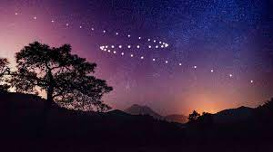
Retrograde Motion
If you were to watch the position of Mars every night, you’d see its position relative to the constellations proceed smoothly from west to east!
Except that occasionally you’d see it back up in its tracks and go from east to west and then back again!
Is Mars really backing up in its orbit?!?

Slide 5
Retrograde Motion
Maybe Jupiter and Saturn’s gravity is dragging it back?!?
But Jupiter, Saturn, Uranus and Neptune can also show retrograde motion.
Even Pluto!
But Mercury and Venus don’t show the effect.
Is this a clue? What’s different between the inner and outer planets?
Would an observer on one of Mars’ moons see Earth go retrograde
Just what the heck is going on here?!?

Slide 6
Retrograde Motion
First, let’s do some calculations…
Earth is 150 million km from the Sun which means its orbit is 2 * pi * 150 million km = 942 million km.
Divide that by 365 get km/day, then by 24 for km/hr, which means that our speed around the Sun is over 107,000 km/hour. Whew!
See, you only think you’re sitting at rest in your nice comfy chair!
Doing the same for Mars gives it a speed of almost 87,000 km/hr, about 80% of Earth’s speed.
Remember, Mars’ year is 687 Earth days.
So while Mars plods along in its orbit, Earth catches up with it and passes it.

Slide 7
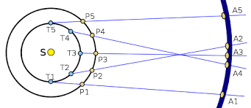
Retrograde Motion
In the diagram we have the Sun in the middle, with the inner ellipse representing Earth and the outer ellipse representing Mars.
So at Time 1 (T1), Mars is at P1 and appears at point A1 in the sky.
At T2, Mars appears at A2.
At T3, Earth has caught up to Mars and appears at A3.
So Mars seems to have moved backwards in the sky!
At T4, Earth has rocketed forward and Mars appears at A4, but is about to do another about-face.
Finally at T5, it has moved forward again.

Slide 8
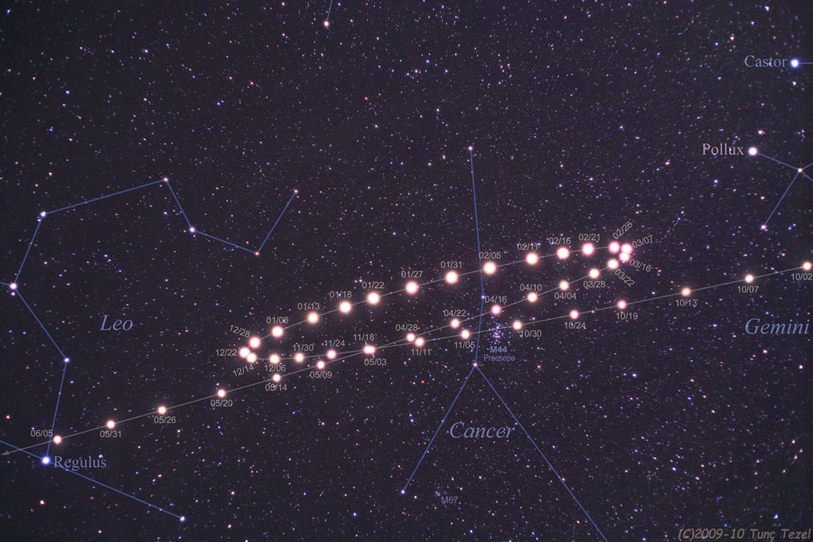

Slide 9
Analemmas
Assuming sunny days and all that, take a picture of the Sun at the same time (e.g. noon) once a week for a year.
Now overlay all the images and you’ll see how the Sun changes its position during the seasons.
Personal side note: I used to live in an apartment building on one side of the Hudson river in New York. On the other side were cliffs called the Palisades.
As the year progressed, I could see the Sun set at progressively more southern spots on the Palisades as the days, weeks and months went by.
Then at the winter solstice, the sunset position would start moving north again until at the summer solstice when it would reach its northern-most position then started heading south again.
So the point where the Sun sets changes through the year. And we know that the Sun doesn’t rise as high in the winter as in the summer.
So what would our picture look like?

Slide 10
Analemmas
So the point where the Sun sets changes through the year. And we know that the Sun doesn’t rise as high in the winter as in the summer.
So what would our picture look like?

Slide 11
Analemmas
http://antwrp.gsfc.nasa.gov/apod/ap081221.html
See https://en.wikipedia.org/wiki/Analemma

Slide 12
Analemmas
Of course, things are different on Mars!
On Mars (calculated image)
http://antwrp.gsfc.nasa.gov/apod/ap061230.html

Slide 13
Where to find this
http://lrs5.net/FTPData/Science/PieceOnEarth.pptx
For those without Powerpoint, check out
http://lrs5.net/FTPData/Science/PieceOnEarth.pdf

