Slide 1
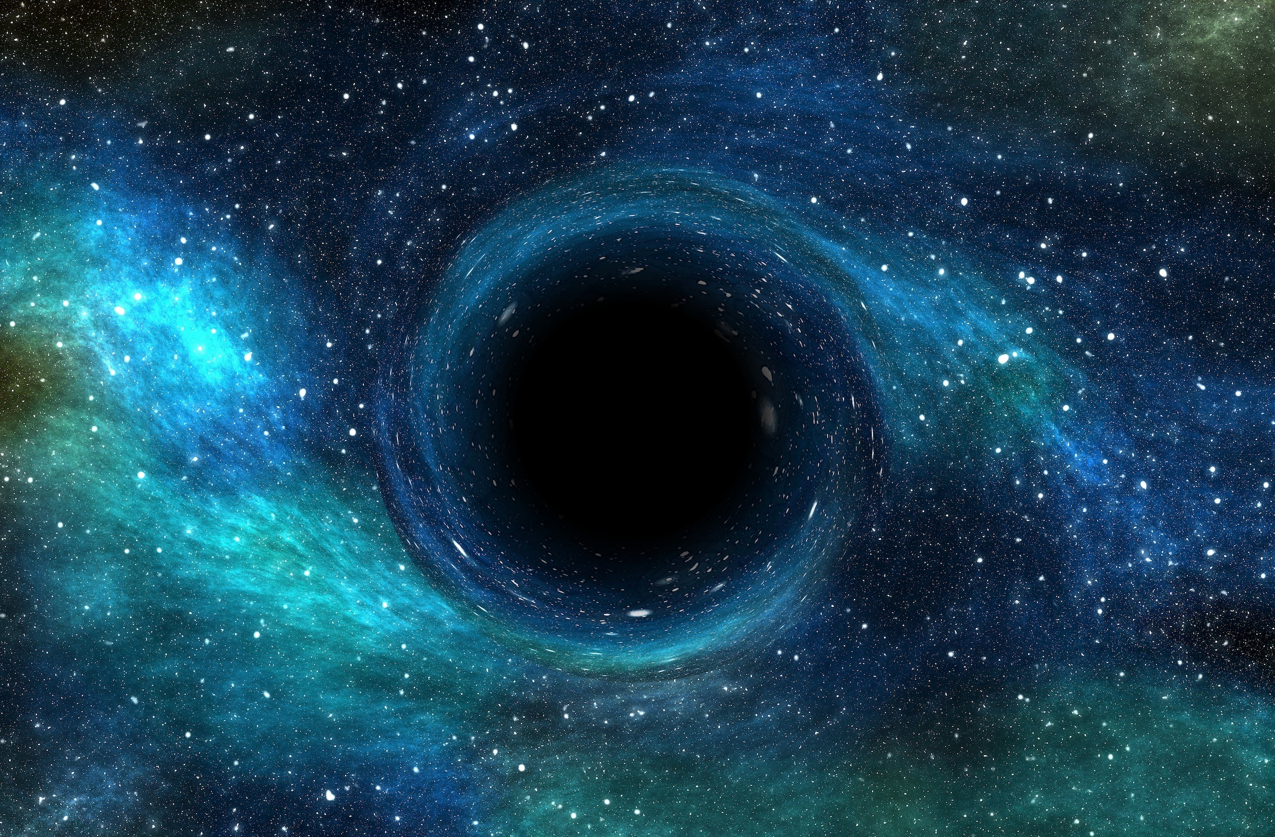
BLACK HOLES

Slide 5
The next big change in our thinking occurred in the early 1900’s after
Einstein published his theory of relativity that improved on Newton’s theory, and
much work was done on the beginnings of quantum mechanics
(first used by name in 1925).
Laplace had failed to consider that gravity can cause objects to collapse and become much more dense than the earth

Slide 6
We don’t fall through the floor because matter appears to be rigid.
Matter is built from particles that repel one another as explained by the laws of quantum mechanics.
This repulsion creates the appearance of rigidity.
However, this rigidity is an illusion, since there is a lot of empty space between particles; the atomic nuclei occupy only a small fraction of the volume of the actual atoms.
Quantum repulsive forces create the illusion of rigidity by opposing the pull of gravity that would bring objects too closely together.

Slide 7
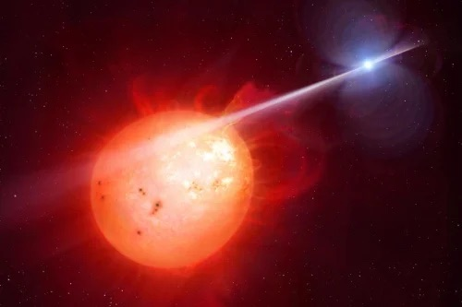
Compared to the other forces that we consider part of our standard model, gravity is quite weak, but it is quite persistent and attracts without limit. Its force gradually but inexorably increases as more and more particles unite in their gravitational pull of one another.
This pull can become so strong that it can lead to gravitational collapse. Many stars resist this collapse early in their lives by the process of nuclear fusion which converts hydrogen to helium, creating a pressure that opposes the collapse.

Slide 8
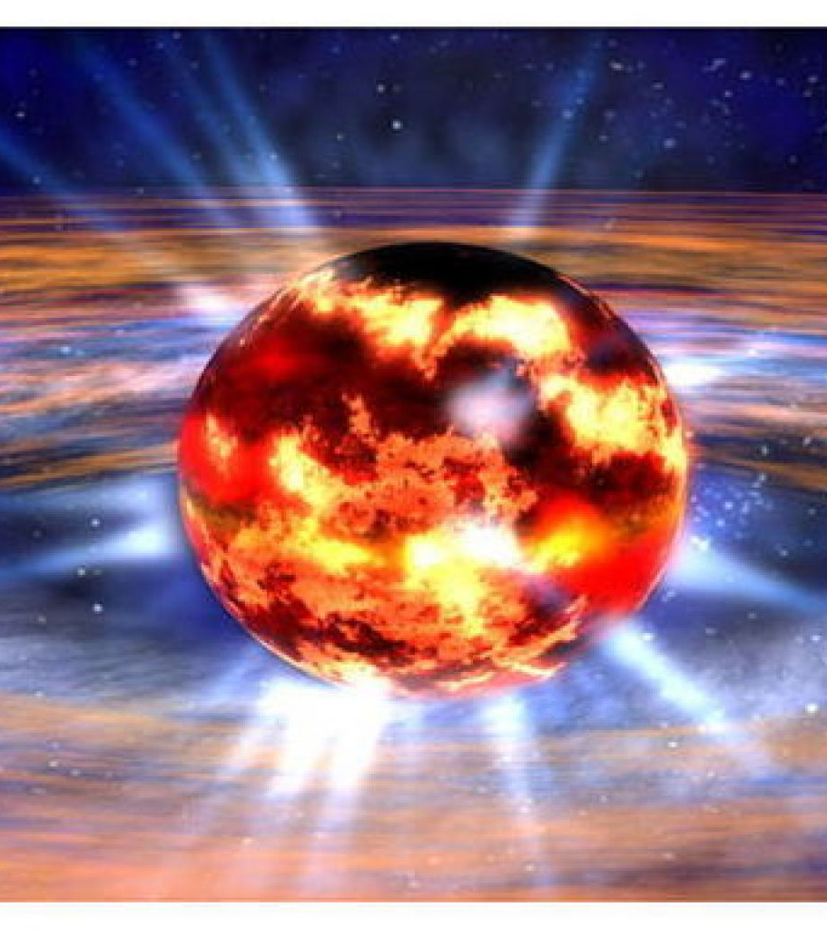
When stars run out of nuclear fuel, their fate depends on the mass of the remaining star.
In 1926, it was proposed (by R.H. Fowler) that another type of pressure that resists gravitational collapse could be conceived using quantum mechanics. Pauli’s Exclusion Principal states that electrons (and other fermions with identical properties to one another) cannot be squeezed into the same region of space.
If they are pushed too close together, they start to jiggle around, jiggling more and more as they are compressed closer and closer together. This creates another type of pressure (known as electron degeneracy pressure) that resists gravitational collapse and can lead to the formation of what are known as white dwarf stars.
These stars can only reach 1.4 times the mass of the sun before they begin to collapse further under the huge gravitational force.

Slide 9
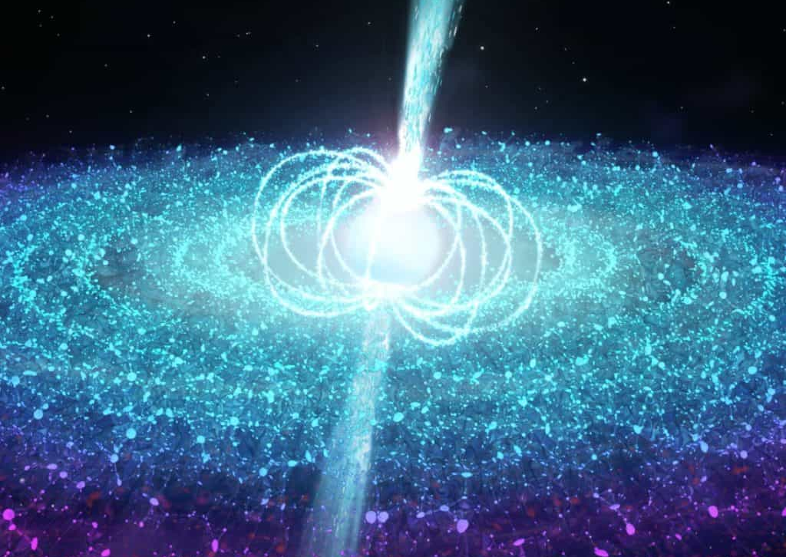
If gravity is great enough, even the electron force is not enough to stabilize the star. Neutrons are brought so close together that they form a soup of neutrons which repel one another using the strong nuclear force.
This forms what is known as neutron stars. Neutron stars can reach somewhere around 3 times the mass of the sun. If more mass is added, then the Neutron Stars would become even more compact, forming a singularity which is so compressed that no one yet knows exactly what is happening inside such an object.

Slide 10
Black holes have masses that can range from slightly greater than the mass of the sun to millions of solar masses. There does not seem to be a limit on the mass of black holes. The largest black hole observed up till now (TON 618) is estimated at 40 billion solar masses.
The term Black Hole was first used in December 1967 during a lecture by John Wheeler. Before this, they were considered as ‘Dark Stars’

Slide 11
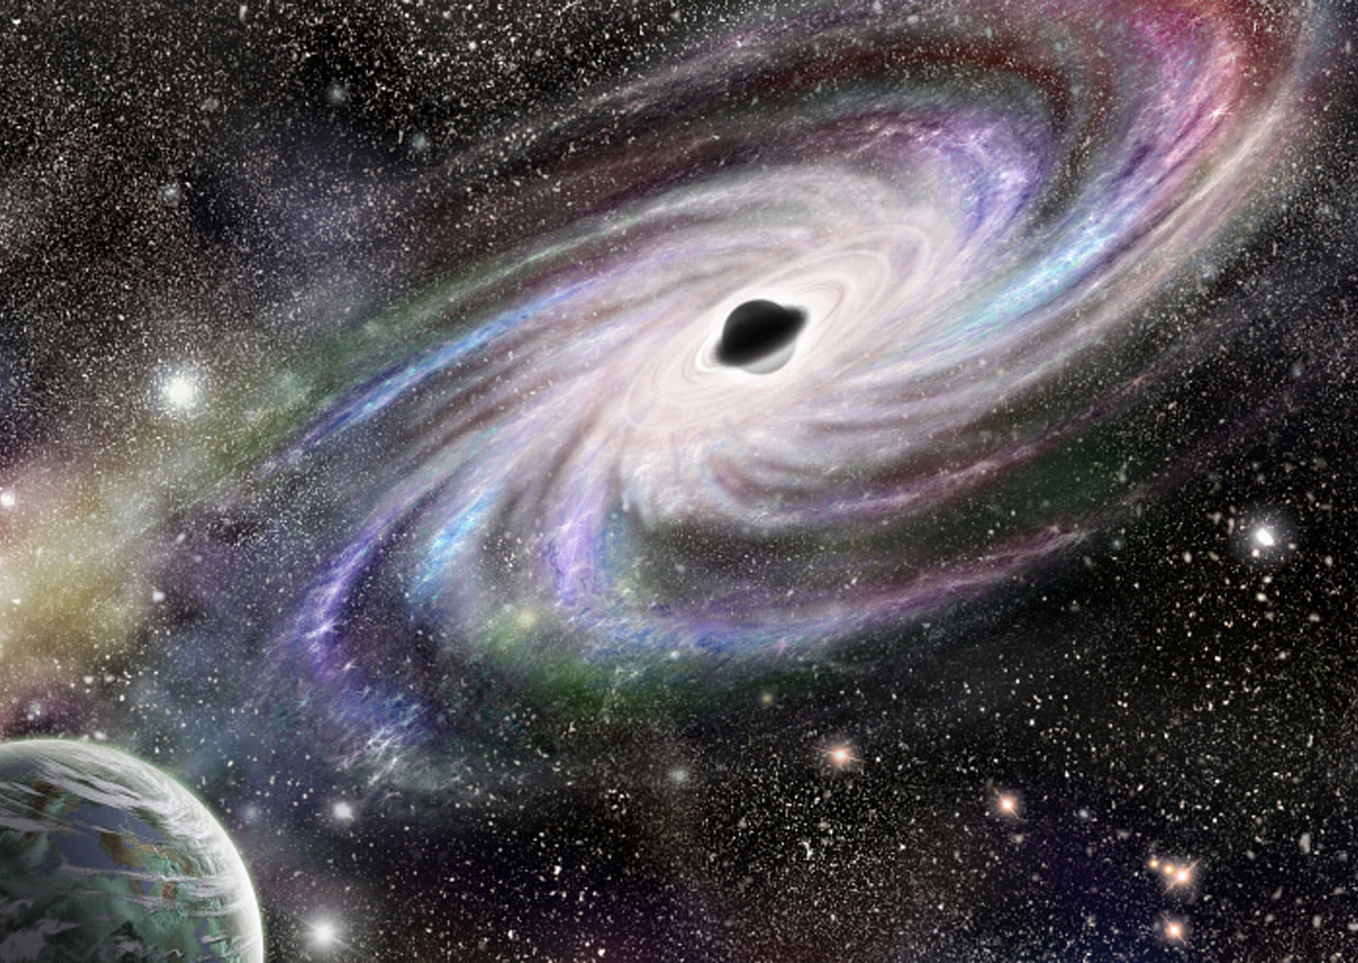
Einstein published his General Theory of Relativity in 1915. A few weeks later, Karl Schwarzschild wrote to Einstein to tell him that he had used this theory to calculate the geometry of spacetime around a star.
Schwarzschild had done this calculation in his spare time while serving the German army on the eastern front by carrying out calculations for the trajectories of artillery shells. He died a few months later from an illness (pemphigus) that developed while he was on the Russian Front.
Schwarzschild’s calculation provides a radius for the black hole. This is where the event horizon would be located.
The Schwarzschild radius is one of the most significant values of a black hole.

Slide 12
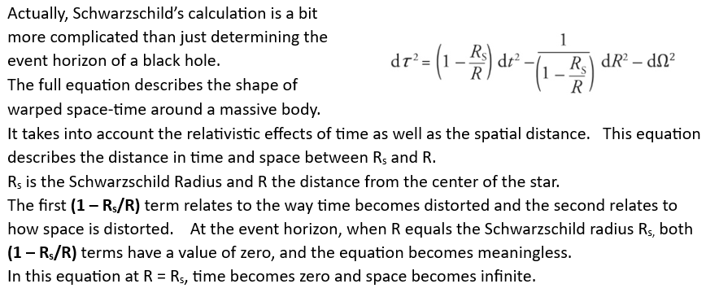

Slide 13
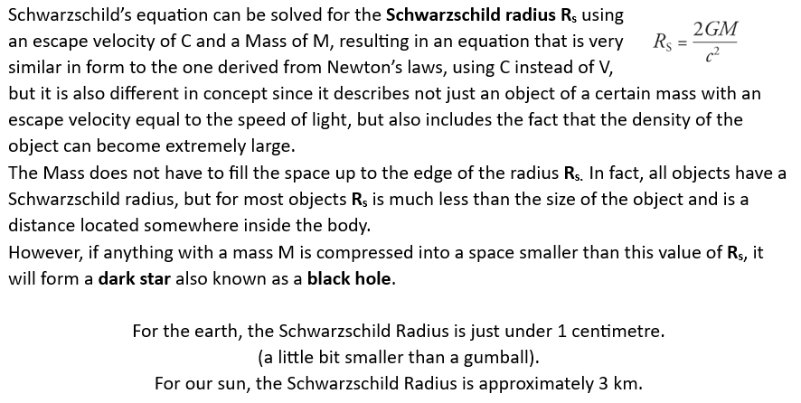

Slide 14
Until we reach the Schwarzschild radius (the event horizon) of a black hole we are still in regular space.
Space and time more-or-less behave similarly to what we are familiar with, although there will be a strong gravitational pull from the black hole.
It would be very easy to simply go beyond the event horizon without realizing that has happened.
We would then be inside the event horizon of the black hole, and subject to some very unusual phenomena.

Slide 15
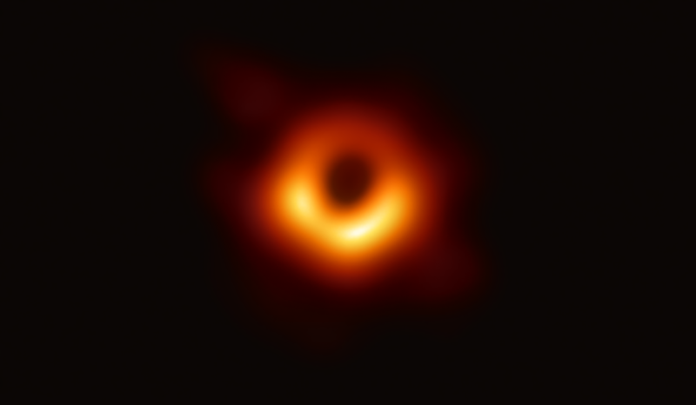
We have seen black holes using some of our best telescopes, so we know that they are more than just a theoretical possibility.
The first was observed in 2019 using the ‘Event Horizon Telescope” array (EHT).
However, even before we could see them, we could see the effects that they had on the other stars and planets near them, so we have already had very strong evidence of their existence for decades.
NASA has prepared an artist impression of the parts of a typical Black Hole, seen from outside.
Notes:
The background shows a photograph of the black hole in the center of M87

Slide 17
We can never see a photograph of what is inside a black hole, since light cannot escape to show us a picture, and neither can any other message.
There will be no radio signals coming from inside a black hole.
If anyone or anything goes beyond the event horizon, they will never be able to tell us what they see.

Slide 18
So, what happens inside a black hole?
To be honest no one knows as a certainty.
Since space and time become very curved inside a black hole, it is very difficult to imagine all that is possible in this strange place.
Fortunately, physicists have never let reality confuse their calculations. In the best ‘Spherical Cow’ philosophy, they simply decided to eliminate the singularity from their imaginary black hole and concentrated entirely on the way that space and time curve, using Schwarzschild’s calculations.

Slide 19
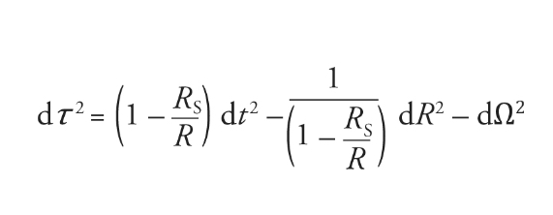
This representation shows a space around a star where R_{s} is the Schwarzschild Radius and R is the radius of the sphere surrounding the star.
As R becomes smaller and approaches Rs, then the (1 - R_{s} /R) values become zero. At smaller values, it becomes negative.
From the perspective of someone falling across the event horizon (R_{s}), nothing unusual happens, and yet from a distant perspective, time stops, and space becomes infinite.

Slide 20
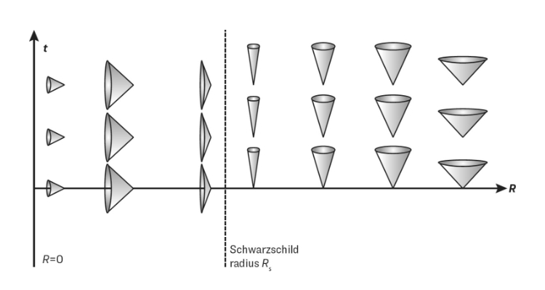
Light Cones on the right of this diagram are what we see in regular space. As we move closer to the event horizon, they become narrower and narrower, becoming infinitely narrow at the Schwarzschild Radius. Indicating that light can only travel in the time direction and can never climb away from the hole.
Inside the event horizon, the light cones have flipped around. This is because the (1 - R_{s} /R) factor has become negative. Because light cones open out in the R direction, this is now the direction of time for anything inside the horizon. This means that anything inside the horizon moves towards the center of the attraction at R=0, just as surely as we move inexorably towards tomorrow,

Slide 21
This is all very confusing! Fortunately, Roger Penrose found an elegant way to show on a simple diagram a representation of what happens inside a black hole.

Slide 22
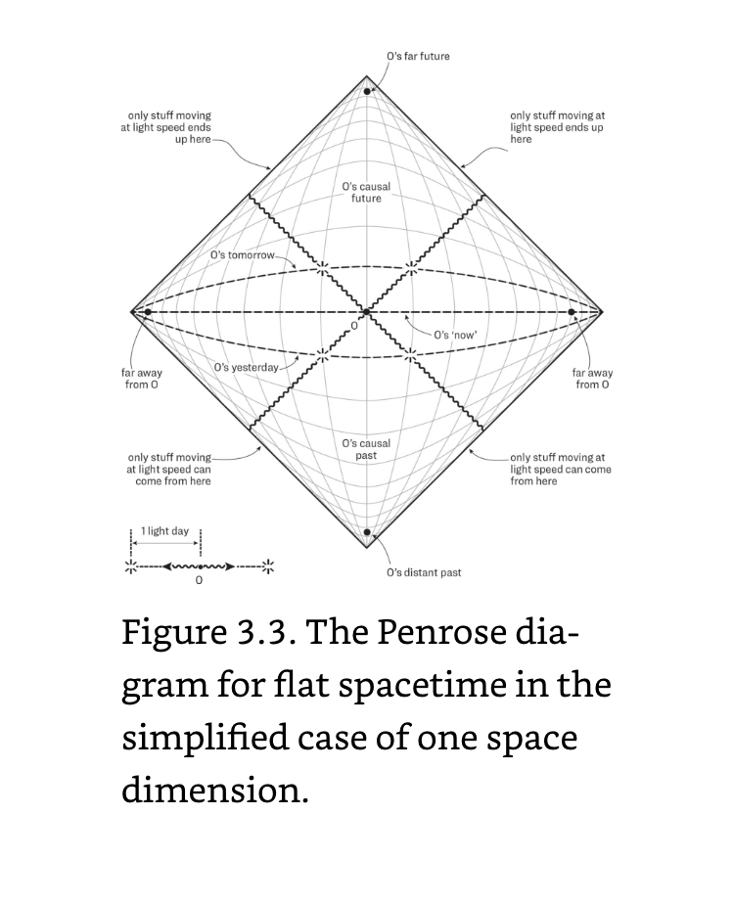
This diagram is a simple Penrose Space-Time Map. Like any map it is a distortion of the reality it represents.
A standard Mercator map of the earth represents the 3-Dimensional sphere of the earth on a 2-dimensional surface. It is reasonably accurate along the equator but becomes quite distorted when you look at the poles where the north and south poles are shown as the line at the top and the bottom of the map, not as the simple points that they are in reality.
Similarly, this Penrose diagram is quite distorted. Light travels along 45-degree lines and Light Cones are always vertical so that time points vertically upward

Slide 23
All 3-D space is shown as a single horizontal line along the center of the drawing. Time is represented as curved lines passing from an infinite point in the past at the bottom of the diagram to an infinite point in the future at the top of the diagram. The two diagonal lines rising from the bottom (infinite past) to the ends of the horizontal line (infinite distance away from the center in all directions) represent the light-cone, the path that light would travel from the infinite past towards the infinite distance. Since we can never reach anything beyond the light-cone, then anything beyond these lines represents the edge of our knowledge. Similarly, the diagonal lines from the end of the horizontal line (the infinite distance) rising towards the top vertex (the infinite future) also represent the light cone from that far away distance to the future. We can never reach anything beyond that barrier.
Notes:
1 light day represents 15 billion kilometers
A larger image will be shown on the next slide

Slide 24
Notes:
1 light day represents 15 billion kilometers
This is normal space without black holes. What happens when a black hole is added

Slide 25
That diagram shows a representation of
normal space-time
What does the diagram look like if a Black Hole is added ?

Slide 26
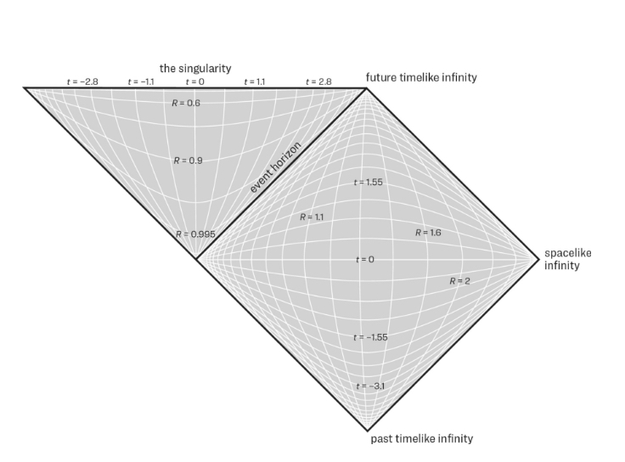
Penrose added to his diagram another showing what happens at a boundary of regular space and an area that represents what happens inside a black hole.
The diamond shape to the left represents space outside of the black hole. The spatial grid instead of being light days is now in terms of Schwarzschild radii. The triangular diagram to the left represents the inside of the black hole. The radii start at the singularity at the top of the diagram, and curve towards the bottom.
On the regular space side of the diagram, we move towards time at the top.
Inside the black hole we move towards the singularity.

Slide 27
So, how do we use these diagrams to tell us anything?

Slide 28
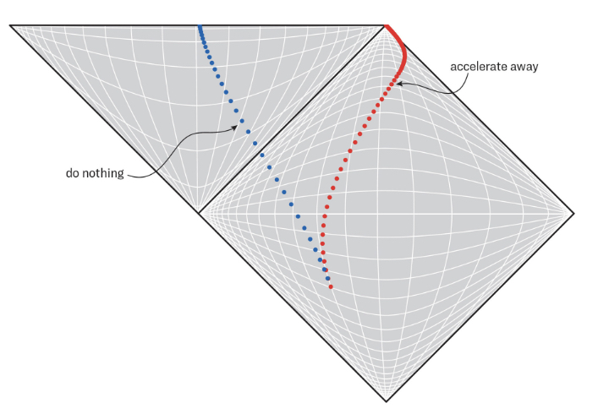
This diagram shows the paths through space-time of two travellers who suddenly come across a black hole. The dots represent 1-hour intervals from their individual perspectives.
Blue is happy just sitting in his spaceship and letting nature take its course without firing his rockets.
Red is more sensible and fires her rockets and accelerates away from the black hole.
Notes:
This black hole would be similar to the one at the center of M87

Slide 29
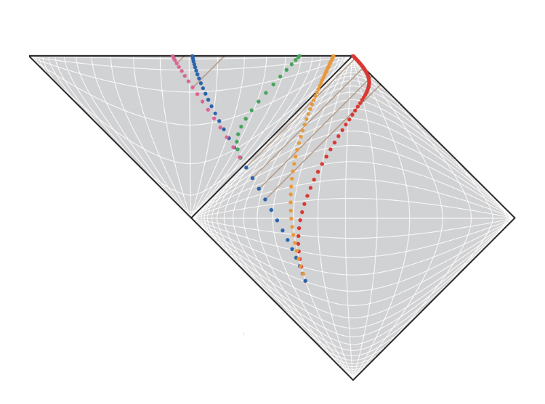
This diagram shows the paths of our friends red and blue as well as three more travellers.
Blue allowed his ship to just float across the event horizon and be drawn towards the singularity. His watch shows 20 dots, which corresponds to almost a day inside the black hole before the end of his time.
Green starts off doing the same thing as blue, but as soon as she crosses the event horizon, she panics, turns her rockets on full power to push away from the singularity. She only has 16 dots across her world line before it ends in the singularity. Her acceleration only made conditions worse for her.
Magenta was with Blue and Green but decides to end it all by accelerating towards the singularity. She has 17 dots on her world line, 1 more than Green.

Slide 30
From Blues perspective, he sees Green recede into the distance above him in the direction of the horizon, while magenta heads away in the direction of the singularity. They both get smaller and smaller as they disappear into the distance in opposite directions
At the top of the diagram are 2 light-beams sent out by Magenta, the first at 9 hours after passing the horizon and the second at 14 hours. The first light-beam hits Blue’s trajectory, so he can see it. However, the second one does not. Blue never sees Magenta hit the singularity. He would continue to see her way down below him as he is winked out of existence
Notes:
No one would ever see anyone else hit the singularity because it always takes light time to travel to our eyes. The singularity represents a single moment in time. Light cannot travel from the point of collision to any other point. Time ends there

Slide 31
What does this like to someone outside the black hole?
Red wisely turned her rockets on and avoided being drawn into the black hole
If we look at the 4 light-beams from blue, we can see that the beams cross Red’s time-line after many of reds time-dots. This means that red experiences many hours for each hour that Blue experiences
Red never sees Blue cross the event horizon since that light beam travels along the line that travels to time at infinity at the top vertex of the diagram. She continues to see light coming from Red forever. She sees him fall towards the horizon at increasingly slow motion until he eventually freezes there. However, since light waves also shift towards the infrared, he also fades away as he approaches the horizon.
Notes:
No one would outside the black hole would ever see anyone fall through the horizon. They slow down, freeze in time and fade away. In fact a person would not see his feet fall through the horizon since light from his feet cannot reach his eyes

Slide 32
Now, let us look at Orange.
She decides to accelerate away from the blackhole, but does
not accelerate enough and eventually crosses the event horizon.
She will see Red (and Magenta and Green) slowing down as they approach the horizon and eventually freeze.
At the instant when Orange’s eyes cross the horizon, she will see the light that left her friends as they crossed the horizon.
Once orange has crossed the horizon, she can see more of the light from her friends, light that left them after they crossed the horizon, but they will appear to be far away, moving very slowly and will also eventually fade away.
Notes:
No one would outside the black hole would ever see anyone fall through the horizon. They slow down, freeze in time and fade away. In fact a person would not see his feet fall through the horizon since light from his feet cannot reach his eyes

Slide 33
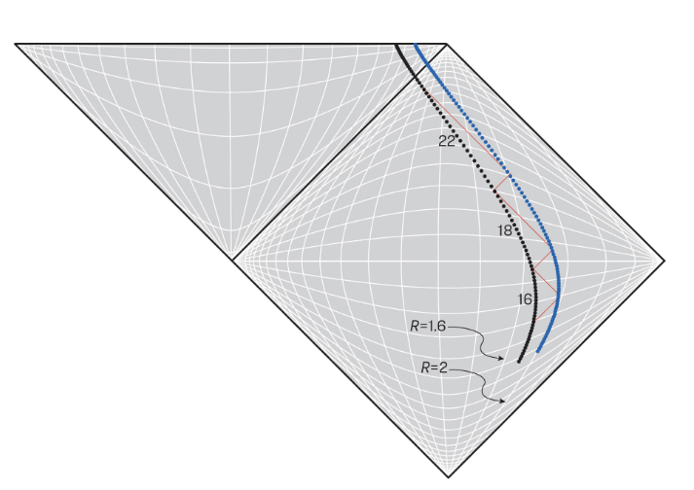
Let us look at 2 objects that are separated by a small distance in space (for example, an astronaut’s head and his feet)
The light beams shown bouncing back and forth between the 2 dots can be thought of as a laser measuring device.
As you can see, as time goes on, the length of these light beams becomes increasingly longer. The astronaut’s head is getting further and further away from his feet. He is being stretched!
We should not be surprised. We know that the gravitational force between the earth and the moon creates strong tides in the ocean. The much larger mass of a black hole can be expected to produce even greater tidal forces.
Astronauts will be spaghettified!

Slide 34
The River Model of a Black Hole ….
Another way to look at it

Slide 35
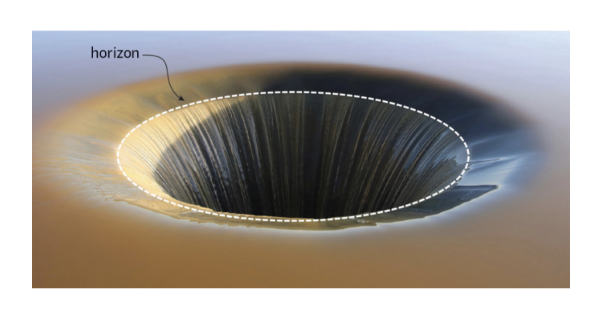
Another way physicists look at black holes is by using what is known as the “River Model.”
In this model, the black hole is thought of as being similar to water flowing into a drain in a bathtub. The water represents space, which flows into the hole at ever-increasing speed.
Far from the black hole, the flow is sedate, and astronauts can easily swim upstream, away from the black hole. As they approach the horizon, the flow reaches maximum speed (light speed) and nothing can swim away. Inside the horizon, the river flows faster than the speed of light as it approaches the singularity.

Slide 36
Since the flow becomes faster as it approaches the singularity, two objects that were a small distance apart become separated as the closer one moves faster towards the center than the one further away. Stretching out anything that falls into the influence of the black hole.
If we think of photons as fish swimming from one object to another before the objects enter the black hole, we can imagine that the fish would have no trouble swimming when the objects are far from the event horizon but have more trouble swimming against the quickly moving stream at closer distances. This would slow down the fish, causing what we see as a red shift. (It would be a closer analogy to imagine that the fish become stretched as they get closer to the horizon, longer fish representing a shift to lower frequencies)

Slide 37
Now for the WEIRD stuff….

Slide 38
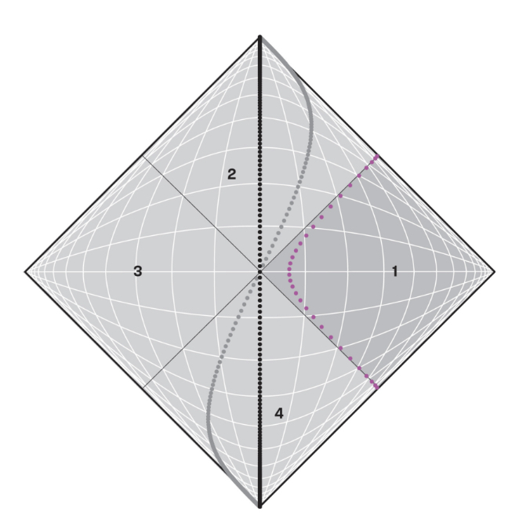
RINDLER
This is a standard Penrose space-time diagram without a black hole.
Imagine that we have an immortal astronaut (Rindler) flying in from the far-right distance at high speed. From the time he enters this space, he wants to head back to his point of origin, so when we first see him, he is moving quickly towards the center of the diagram, but constantly accelerating away from the centre towards the right. He finally reaches a point some distance from the center where he stops moving towards the center and starts moving, ever more quickly, towards the left. His path is shown in this diagram as the red dots.
Wolfgang Rindler was a physicist who introduced the term “Event Horizon”
Notes:
Wolfgang Rindler was a physicist who introduced the term “Event Horizon”

Slide 39
Because Rindler is constantly accelerating in a direction towards the right (even though he was initially moving at high speed towards the left) he feels a constant force pushing him into his seat.
The trajectory he follows is known as a Rindler Trajectory. The most striking thing of this trajectory is that it stays entirely within the right quadrant of the diagram. (Labeled “1”)
He can see anything that happens within this quadrant. Light beams from anywhere in this quadrant travelling at 45° will intersect Rindler’s trajectory
However, Rindler cannot receive signals from regions 2 or 3! Regions 2 and 3 are beyond Rindler’s horizon.
Region 4 is different. Rindler can receive signals from Region 4, but he cannot send signals to this region.

Slide 40
The Penrose Diagram for normal space with a black hole looks very unsymmetrical.
Physicists like symmetry, so they thought that they might be able to add some additional regions to make this more to their liking
It turns out we have only been drawing half of the Schwarzschild solution to Einstein’s equations

Slide 41
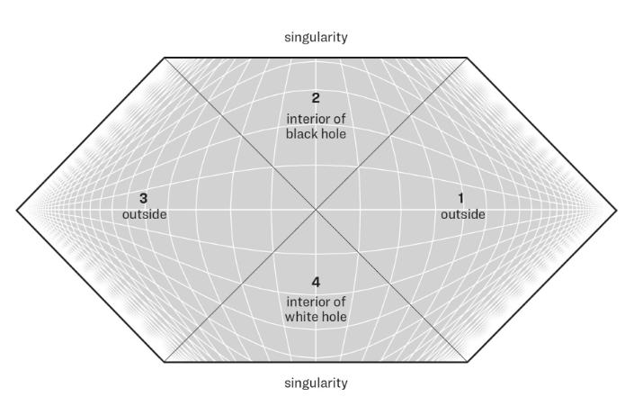
When we draw the full solution, this is what we get! This is known as Maximally Extended Schwarzschild spacetime
Region 1 represents the entire infinite universe outside of the black hole.
Region 2 represents the region inside the black hole, including the end of time.
So, you might be asking yourself, what is Region 3 and Region 4???
Notes:
Einstein did not have Penrose Diagrams, but realized that at the bottom apex of the black hole there is an opportunity to form a bridge through spacetime. This conjecture is known as an Einstein-Rosen Bridge. Today this is known as a wormhole

Slide 42
Since Light always travels at 45° angles on this diagram, we can start to recognize some relationships between these regions.
Things can travel from Region 4 into regions 1, 2, and 3, but the reverse is not possible.
Region 3 is inaccessible from Region 1 and Vise Versa
Region 3 is a whole other infinite universe, completely separated from Region 1, but linked somehow inside the black hole
Astronauts from Region 1 and Region 3 could jump into the black hole (Region 1) and meet briefly before their rendezvous with the singularity

Slide 43
Notice also that Region 4 has a singularity at the bottom of the diagram. Nothing can ever enter this singularity, since nothing (we know of) can travel in that direction.
Anything that lives long enough in Region 4 must eventually pass through one of the 2 horizons into Region 1 or Region 3
Anyone in Region 1 or Region 3 could encounter stuff that emerges from Region 4. This is the reverse of a Black Hole, so it is called a “White Hole”
Astronauts from Regions 1 or 3 can jump into the black hole of Region 2, but Region 4 would be in their past. Even though they may receive signals from it, they could never enter it

Slide 44
To Explore this a little more, let us consider some slices through this space.

Slide 45
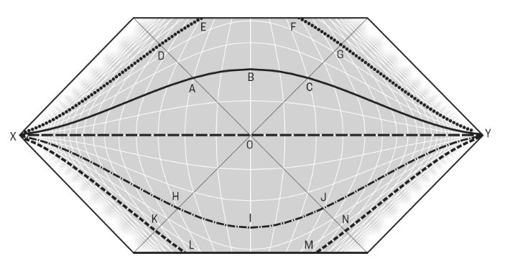
Let us consider these 5 slices through the same space taken at different times.
Earlier times are at the bottom of the diagram with later times at the top. (Time moves from the bottom to the top).

Slide 46
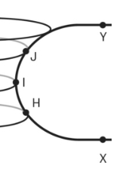
Consider the line X..H..I..J..Y in space
From Y to the event horizon, space is normal and flat. It begins to curve at the event horizon (J) and continues to curve inside the White Hole then, its curve becomes less as it approaches the next event horizon and finally it becomes flat in normal space again

Slide 47
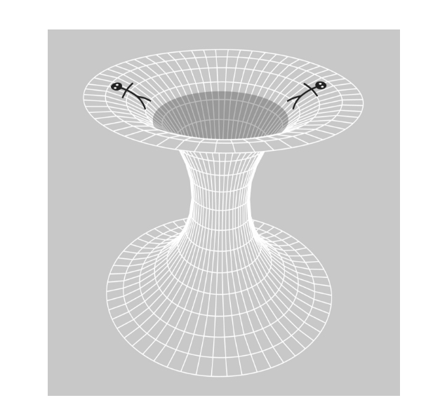
Let us now take this one-dimensional line and rotate it into a 2-dimensional surface.
This would be a wormhole from Universe 1 to Universe 3

Slide 48
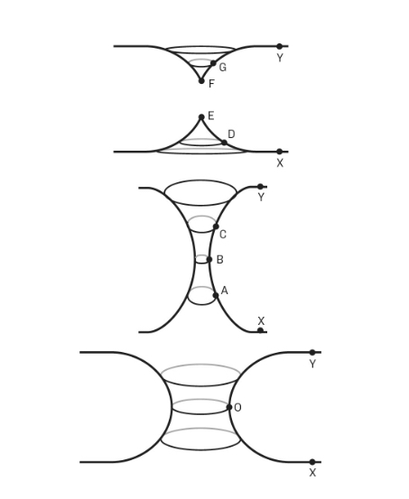
We see that the line X-H-I-J-Y formed a beautiful wormhole. Now, let us look at what the other lines do. Remember that these lines represent the same region of space, with only time advancing
These 3 curves will be expanded in the next slide to show them in more detail.

Slide 49
Remember that these 3 curves show the same section of space over different times. The curve on the bottom is at time ‘0’, the one in the middle is a bit later and the one at the top is later still.
It can be seen that the wormhole stretches open, begins to narrow out and then snaps, leaving 2 disconnected universes.
Nothing can travel all the way through the wormhole before it snaps

Slide 50
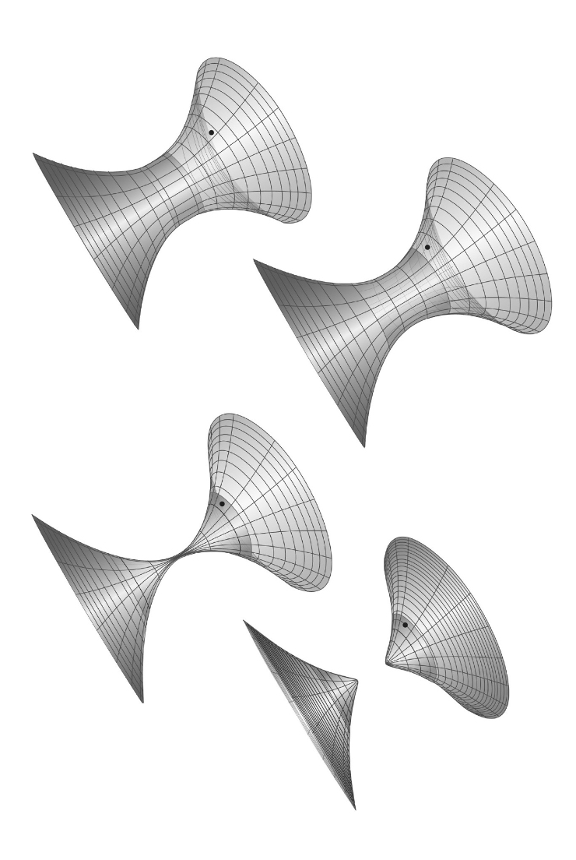
This is a nicer drawing showing a 2-D representation of the wormhole as it narrows and finally snaps.

Slide 51
The Penrose Diagram shows the same result
There is no line at 45° that connects Region 1 and Region 3. Travel between these 2 regions is not possible.

Slide 52
Does that completely rule out travelling through wormholes?
Not Exactly …

Slide 53
Sometimes Physicists have to be cold mathematicians who follow the numbers and the rules to find hidden truths in nature.
Other times, they have to be more like sleezy contract lawyers who search through documents to find a loophole that lets them do something unexpected

Slide 54
Black Holes are surrounded by huge accretion disks of matter swirling around the black hole before eventually disappearing behind the event horizon.
This matter is moving at near to light speeds as it orbits and finally crosses the horizon.
This implies that the matter brings massive amounts of angular momentum to the interior of the black hole.
Our discussion up till now has involved the Schwarzschild formula for curved time and space.
The Schwarzschild formula assumes a non-rotating black hole

Slide 55
In 1963, New Zealand mathematician Roy Kerr succeeded in finding a solution to Einstein’s equations for a spinning black hole.
This solution showed a lot of complexity that develops compared to a non-rotating black hole.
A Kerr black hole bulges at the equator and is symmetrical only about its axis of spin.
There are 2 categories of Kerr black holes, slowly spinning and faster spinning

Slide 56
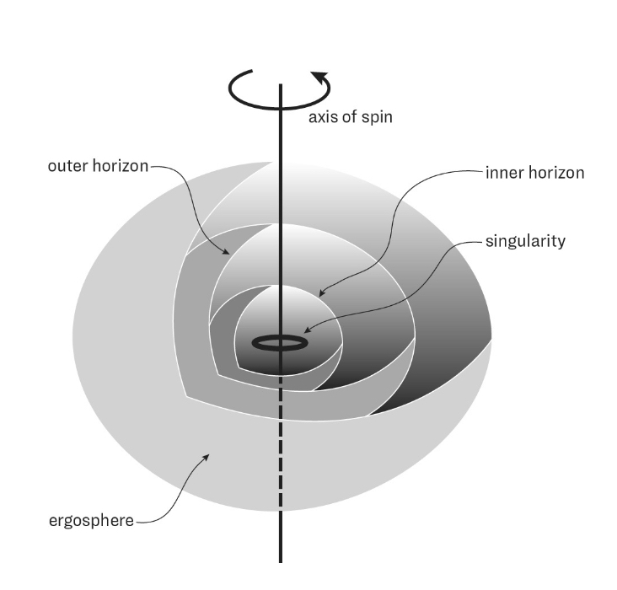
This is a sketch of a slowly spinning Black Hole
There are a few details that should be noticed:
The singularity is not just a point, but is a ring
The plane of the ring is aligned at right angles to the spin axis
Only trajectories in the equatorial plane will meet the singularity, all other trajectories will miss it.
The hole has 2 event horizons, the inner and the outer horizons
There is a region outside of the outermost horizon where space is being dragged around so violently that it is impossible for anything to stand still. This is shown as the ergosphere.

Slide 57
How would this appear to an astronaut who happened to enter this rotating black hole?
The astronaut would first enter the ergosphere.
The outer surface of the ergosphere is where light rays travelling radially outward would freeze. This is the event horizon of the black hole in the Schwarzschild definition, however for the Kerr geometry, this does not represent a point of no-return.
An astronaut entering this space would be spun around with all of space as it circles the black hole. This motion of space creates a light cone that extends outside the ergosphere. An astronaut can travel along the part of the light cone that leads outside the ergosphere and escape the black hole.

Slide 58
After crossing the ergosphere, if the astronaut continues, she will come to the outer horizon.
The outer horizon is the point of no return, similar to the event horizon of a Schwarzschild black hole.
The astronaut then has no option but to continue in to cross the inner horizon.
The situation inside the inner horizon is markedly different from a Schwarzschild black hole.
The astronaut is not necessarily going to meet the singularity. The astronaut can navigate to avoid the singularity and the end of time.

Slide 59
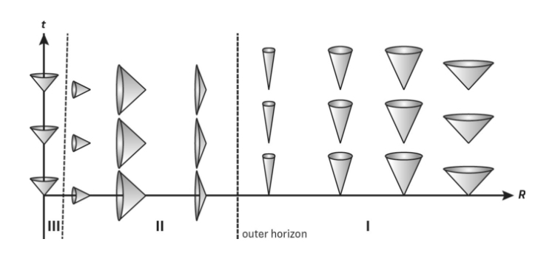
These light cones show the difference in the Kerr Black Hole.
Far away in space the cones are similar to the Schwarzschild Black Holes.
After crossing the outer horizon, they continue to be similar, and the astronaut must inexorably pass to the inner horizon.
However, once the inner horizon is passed, the light cones tip back up again and the astronaut can navigate within the region once more

Slide 60
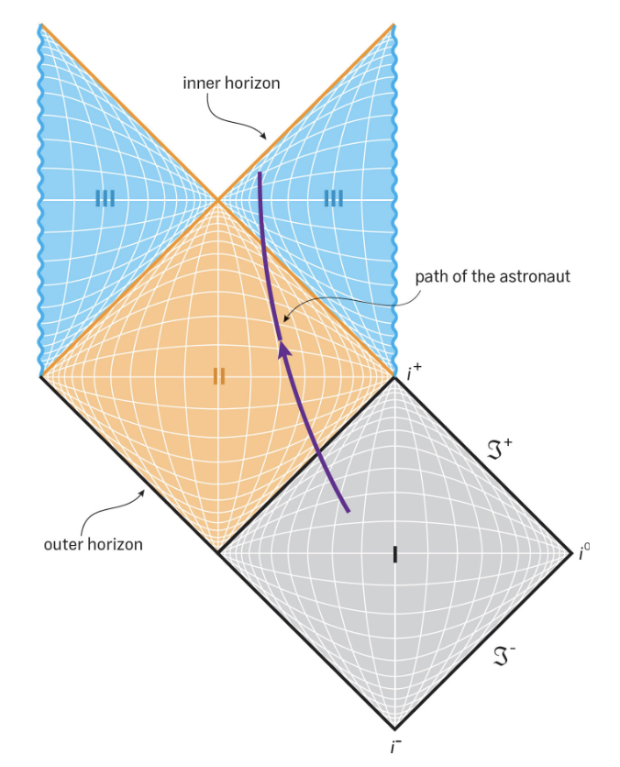
This Penrose diagram shows what happens inside a Kerr Black Hole.
The astronaut passes from regular space (Region I) through the outer horizon into Region II, where she is inexorably drawn to the inner horizon, passing into Region III. Region I and II are similar to a Schwarzschild Black Hole
In Region III, the singularity (indicated by the wiggly vertical line at the edge of Region III) is time-like, meaning it is visible to the astronaut. Light beams can travel at 45° from the singularity and reach the astronaut. This is different from the spacelike singularity of the Schwarzschild Black Hole.
The astronaut can navigate to avoid the singularity.

Slide 61
If we look at the top of this diagram, we notice that the top 2 diagonal orange lines are horizons, not singularities or boundaries (i.e., infinite time or infinite distance).
If there is a boundary, then there must be something beyond it, and our diagram must be extended to include what lies beyond.

Slide 62
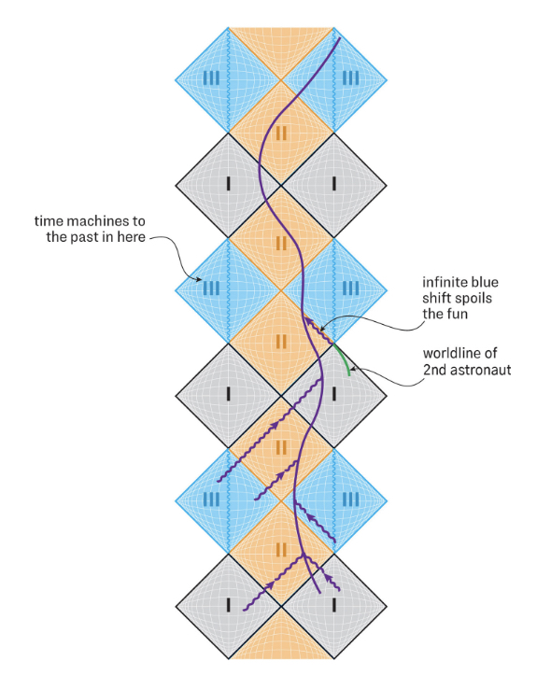
If we fill in the missing space, we find an infinity of infinite universes. This is quite shocking.
This is the unique way to extend the diagram and remain consistent with general relativity.
This diagram represents an infinite tower of universes, which means that there is an infinite amount of time and space tucked away inside a Kerr Black Hole
Let us look again at our astronaut who started in normal space (Region I) at the bottom of the page. She travelled through the outer horizon end entered Region II, the region between the outer and inner horizons. While in Region II she can receive signals from Region I, our universe, but also from the other Region I, some other universe. Like the Schwarzschild black hole, she has no option but to eventually pass the inner horizon into Region III

Slide 63
In Region III there is the looming singularity (the vertical wavy line down the center of Region III), but she can see it and avoid it. She can choose to avoid it and pass through the horizon into the second Region II. This region is bounded by a horizon, but it is the horizon of a white hole, a gateway into a different Region I – another universe, which she can explore for eternity if she likes.
Or, she can find another Kerr Black Hole in this new universe and chose to enter into it, repeating the whole adventure again.

Slide 64
Another interesting result of Kerr’s mathematics relates to what happens if the astronaut passes through the ring singularity in Region III.
In this region of Spacetime (in the universe on the other side of the ring singularity), gravity pushes rather than pulls. It is an anti-gravity universe.
The astronaut can turn around and pass back through the ring singularity to the normal inner region, but in the process, she can arrange things so that she emerges at a time before she entered the ring singularity the first time.
There are paths in Region III that loop back and return to the same point. These paths are known as ‘closed time-like curves’. This is time travel.
The Kerr Black Hole is also a time machine, sometimes known as a Carter Time Machine after Brendon Carter who first discovered it.

Slide 65
This is all pretty amazing!
However, most physicists believe that although it works mathematically, it is impossible in reality.
Real Black Holes are made from collapsing matter. The presence of matter changes the space-time inside the horizon of a black hole, blocking up the portals into other universes. This is ignored in both the Schwarzschild and the Kerr mathematics.
If we look at the Green Line in the second Region I from the bottom, we can see a second astronaut sending signals to the main one who has entered Region II. These signals bunch together as time approaches infinity and combine as they enter the black hole along the inner horizon. This becomes an infinite flux of energy that would form a singularity and seal off Region III. The inner horizon would become a singularity of its own.

Slide 66
A slowly spinning black hole can be described by Kerr’s mathematics. This description makes some amazing predictions of what the universe would be like.
inside one of these black holes
However, the simplifying assumptions used in the mathematics results in some predictions that seem very unlikely in reality.
What does the mathematics tell us about a Fast Spinning Black Hole?

Slide 67
Fast-Spinning Black Holes are ones with a spin (J/c) greater than one half of the Schwarzschild radius.
In this definition, J is the angular momentum of the hole divided by its mass and c is the speed of light .
For the Earth (J/c) is roughly 10 meters and for the sun it is roughly 1 kilometer.
For the Earth R_{s} is less than 1 centimeter and for the sun it is roughly 3 kilometers.
The earth would be considered very fast spinning if it were a black hole, but the sun would not be in the fast-spinning category.

Slide 68
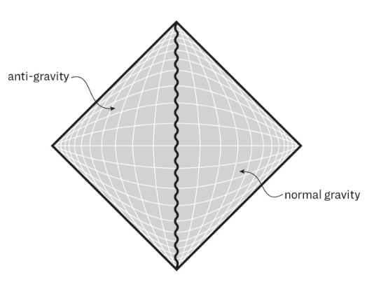
The Penrose Diagram for a fast-spinning Black Hole is much simpler than the one we saw for a slow-spinning black hole. The Space-Time is much simpler.
However, the calculations involve what is known as a Naked Singularity.
The event horizons have disappeared, leaving just the ring singularity (the wiggly line) which remains a portal to an infinite space where gravity repels rather than attracts
A naked singularity is one in which the universe is not protected by an event horizon.
All event horizons have disappeared!

Slide 69
Naked Singularities are to physicists akin to what the Gates of Hell would be to a religious person.
They are like a strong curse on the Universe.

Slide 70
The problem with Naked Singularities is that the world becomes non-deterministic. The past would be insufficient to predict the future.
Because of the vertical space-like horizon of the ring singularity, light rays from the singularity can reach and influence any event in the universe. But the singularity is where the known laws of physics break down. This means that every event in spacetime can be influenced by an unpredictable region of spacetime.
This means that physicists (and pretty well everyone else), who base their career on predicting the future from a knowledge of the past, would be unable to continue with that belief.

Slide 71
SUMMARY
Black Holes Exist
They were predicted as far back as 1783 using Newtonian Mathematics
The General Theory of Relativity and Quantum Mechanics improved on these predictions
Black holes have been seen by our telescopes
The spacetime warping that happens around and inside a black hole can be predicted using the mathematics of Schwarzschild for non-rotating black holes and Kerr for rotating black holes
The spacetime can be imagined using Penrose diagrams.
Inside a black hole, space and time become inverted. Space acts like time and time acts like space
Objects that fall past the event horizon of a black hole must travel to the singularity. They become stretched and spaghettified. Time behaves strangely between what they observe and what others alongside them observe.
Wormholes can exist, but they do not exist long enough in time to allow anyone to pass through them.

Slide 72
SUMMARY
SUMMARY
It is possible that there may be at least one more universe on the other side of a black hole.
Rotating black holes may have a disc singularity rather than a single point. This can lead to some unusual possibilities, some more likely than others
Fast-rotating black holes can lead to a Naked Singularity, something that physicists fear and would like to believe cannot exist. They may be wrong.

Slide 73
BLACK HOLES - PART 2
Part 2 will look at later chapters of this book.
These chapters discuss the energies of black holes, Hawking Radiation, Holograms and more amazing predictions about what we think we know about black holes.
COMING SOON TO A PHYSICS MEET-UP NEAR YOU!!!!

